Slide 1
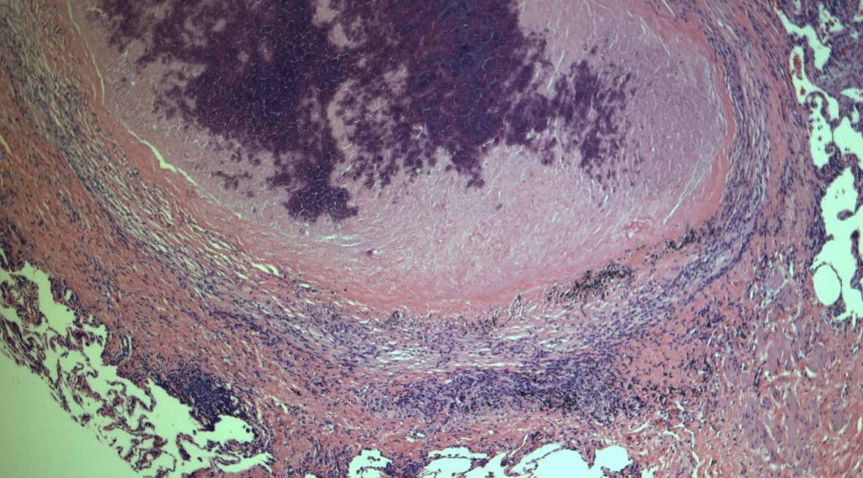
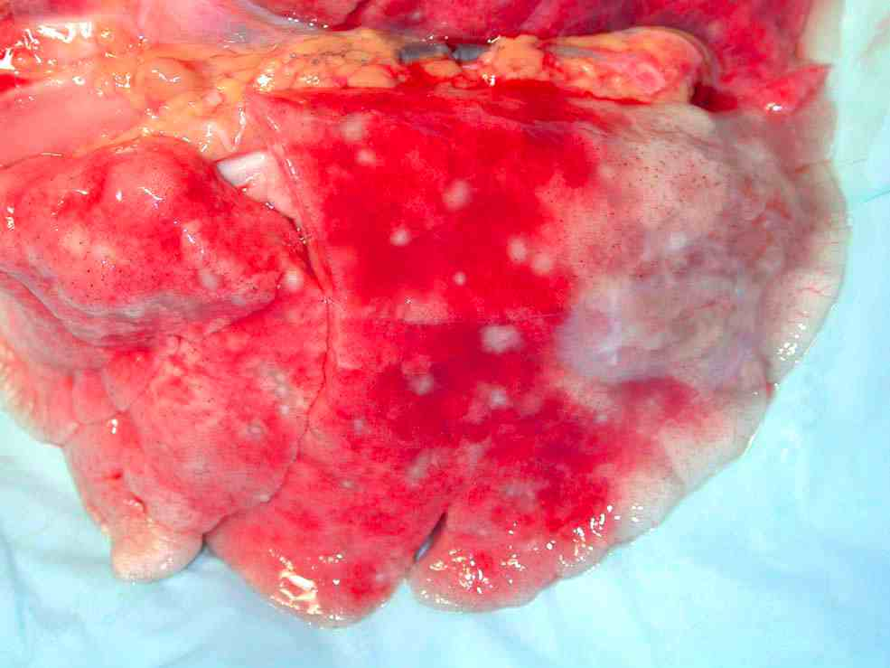
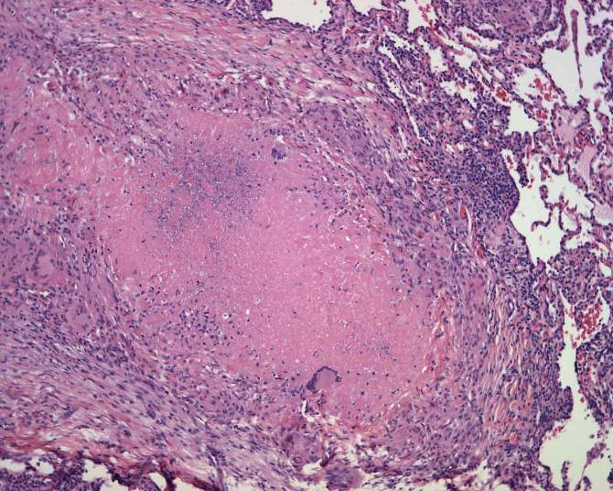
A Multi-scale and Multi-system Approach to Understand Granuloma Formation in TB
Denise E. Kirschner
Jennifer Linderman
Steven Kunkel
University of Michigan Medical School
JoAnne L. Flynn
University of Pittsburgh School of Medicine

Slide 2
TB: 9 million new cases per year
per 100 000 population
< 10
10 to 24
25 to 49
50 to 99
100 to 299
300 or more
No Estimate
1.9 million deaths per year

Slide 3
Tuberculosis in humans
unsuspecting person
TB man
?
clear infection
not infectious
Mtb
5-10%
primary tuberculosis
infectious
90%
latent tuberculosis
not infectious
time
immunocompromise
reactivation
no active disease
5-10%
(not infectious)
active tuberculosis
(infectious)

Slide 4
Tuberculosis in humans
unsuspecting person
TB man
?
clear infection
not infectious
Mtb
5-10%
primary tuberculosis
infectious
90%
latent tuberculosis
not infectious
time
2 BILLION PEOPLE
reactivation
no active disease
5-10%
(not infectious)
active tuberculosis
(infectious)

Slide 5
Course of Mycobacterium tuberculosis infection
parenchyma
airways
IL-12
Bacterial replication
and spread
No initial destruction
Bacteria replicate
IL-1
MØ
chemokines
LUNGS
MØ
TNF
DC
Activated MØ
Destroy bacillus
PRIMING
T CELLS
NO INFECTION
Lymph node
macrophage
Recruitment of
T cells and MØ
T cell
GRANULOMA
LUNG

Slide 6
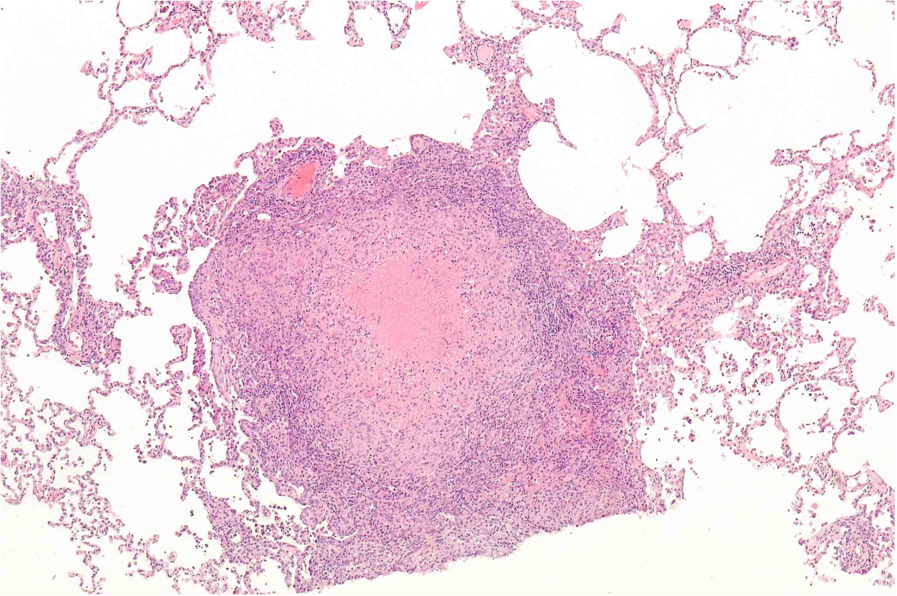
COURSE OF INFECTION
Granuloma
Control of replication
inadequate control
of replication
fibrosis
Latent TB
Immunosuppression?
No disease
(control of replication
for lifetime)
Bacterial replication
REACTIVATION
ACTIVE TB

Slide 7
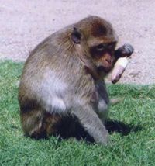
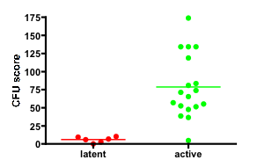
Clinical definitions for classification of monkeys following Mtb infection
100%
+ M. tb
Erdman
25 cfu
via bronchoscope
Tuberculin Skin Test +
Other immunologic tests +
2-6 weeks
6-8 months
Cynomolgus macaque
ACTIVE TB (43%)
LATENT TB (52%)
Positive Chest x-ray
Mycobacterial culture
•+ GA or BAL
Clinical signs
•weight loss,
•appetite loss
•cough
No signs of disease
CXR negative
Mycobacterial culture
negative after 2 months
Clinical signs--none
Bacterial load

Slide 8
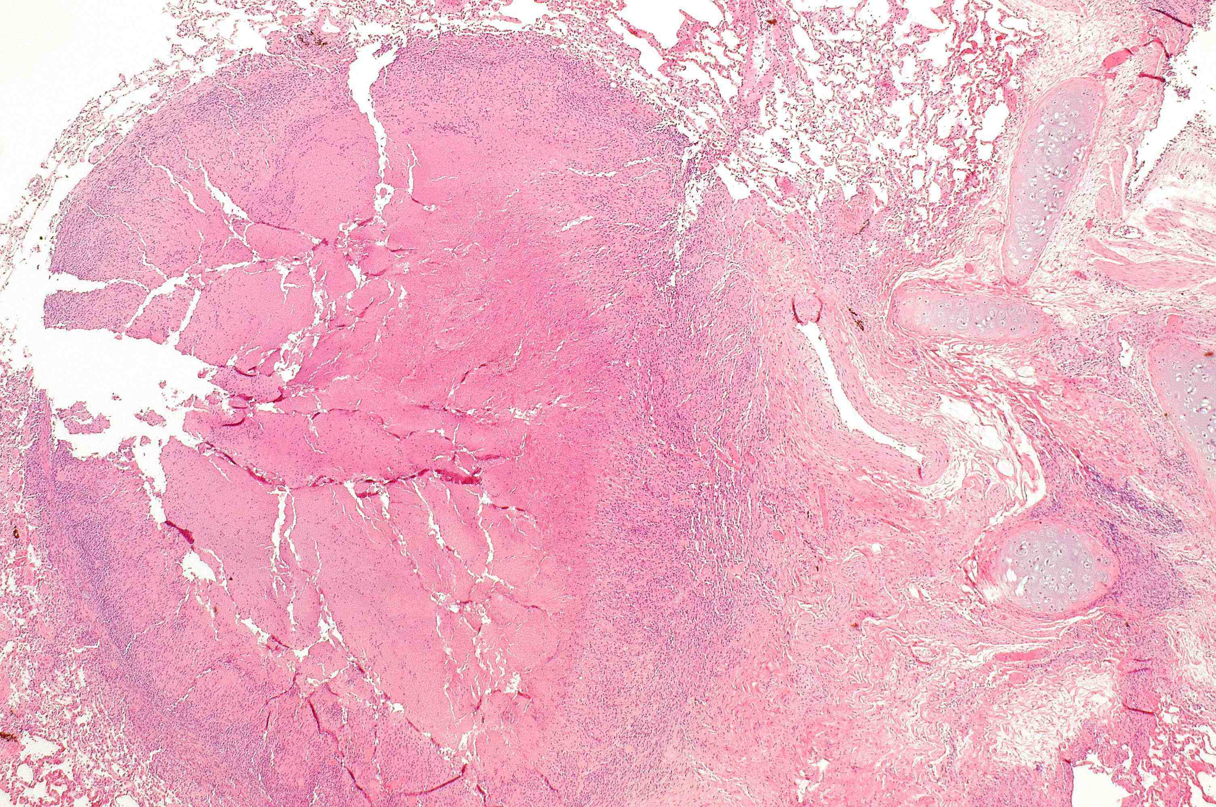
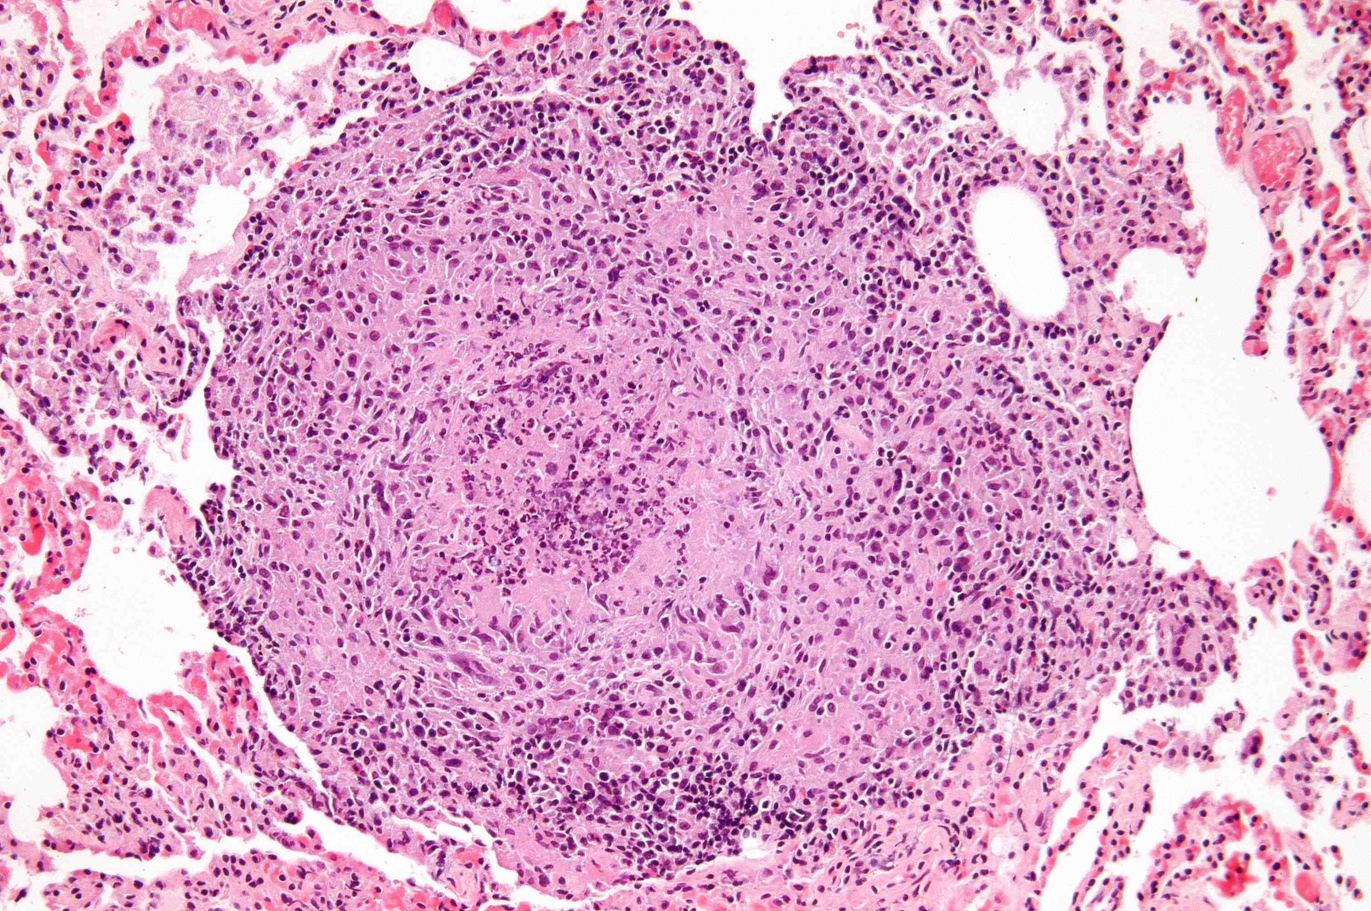
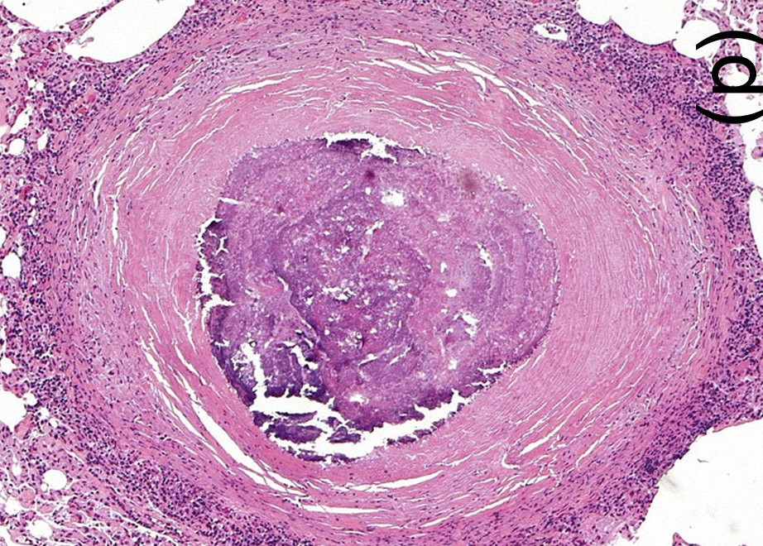
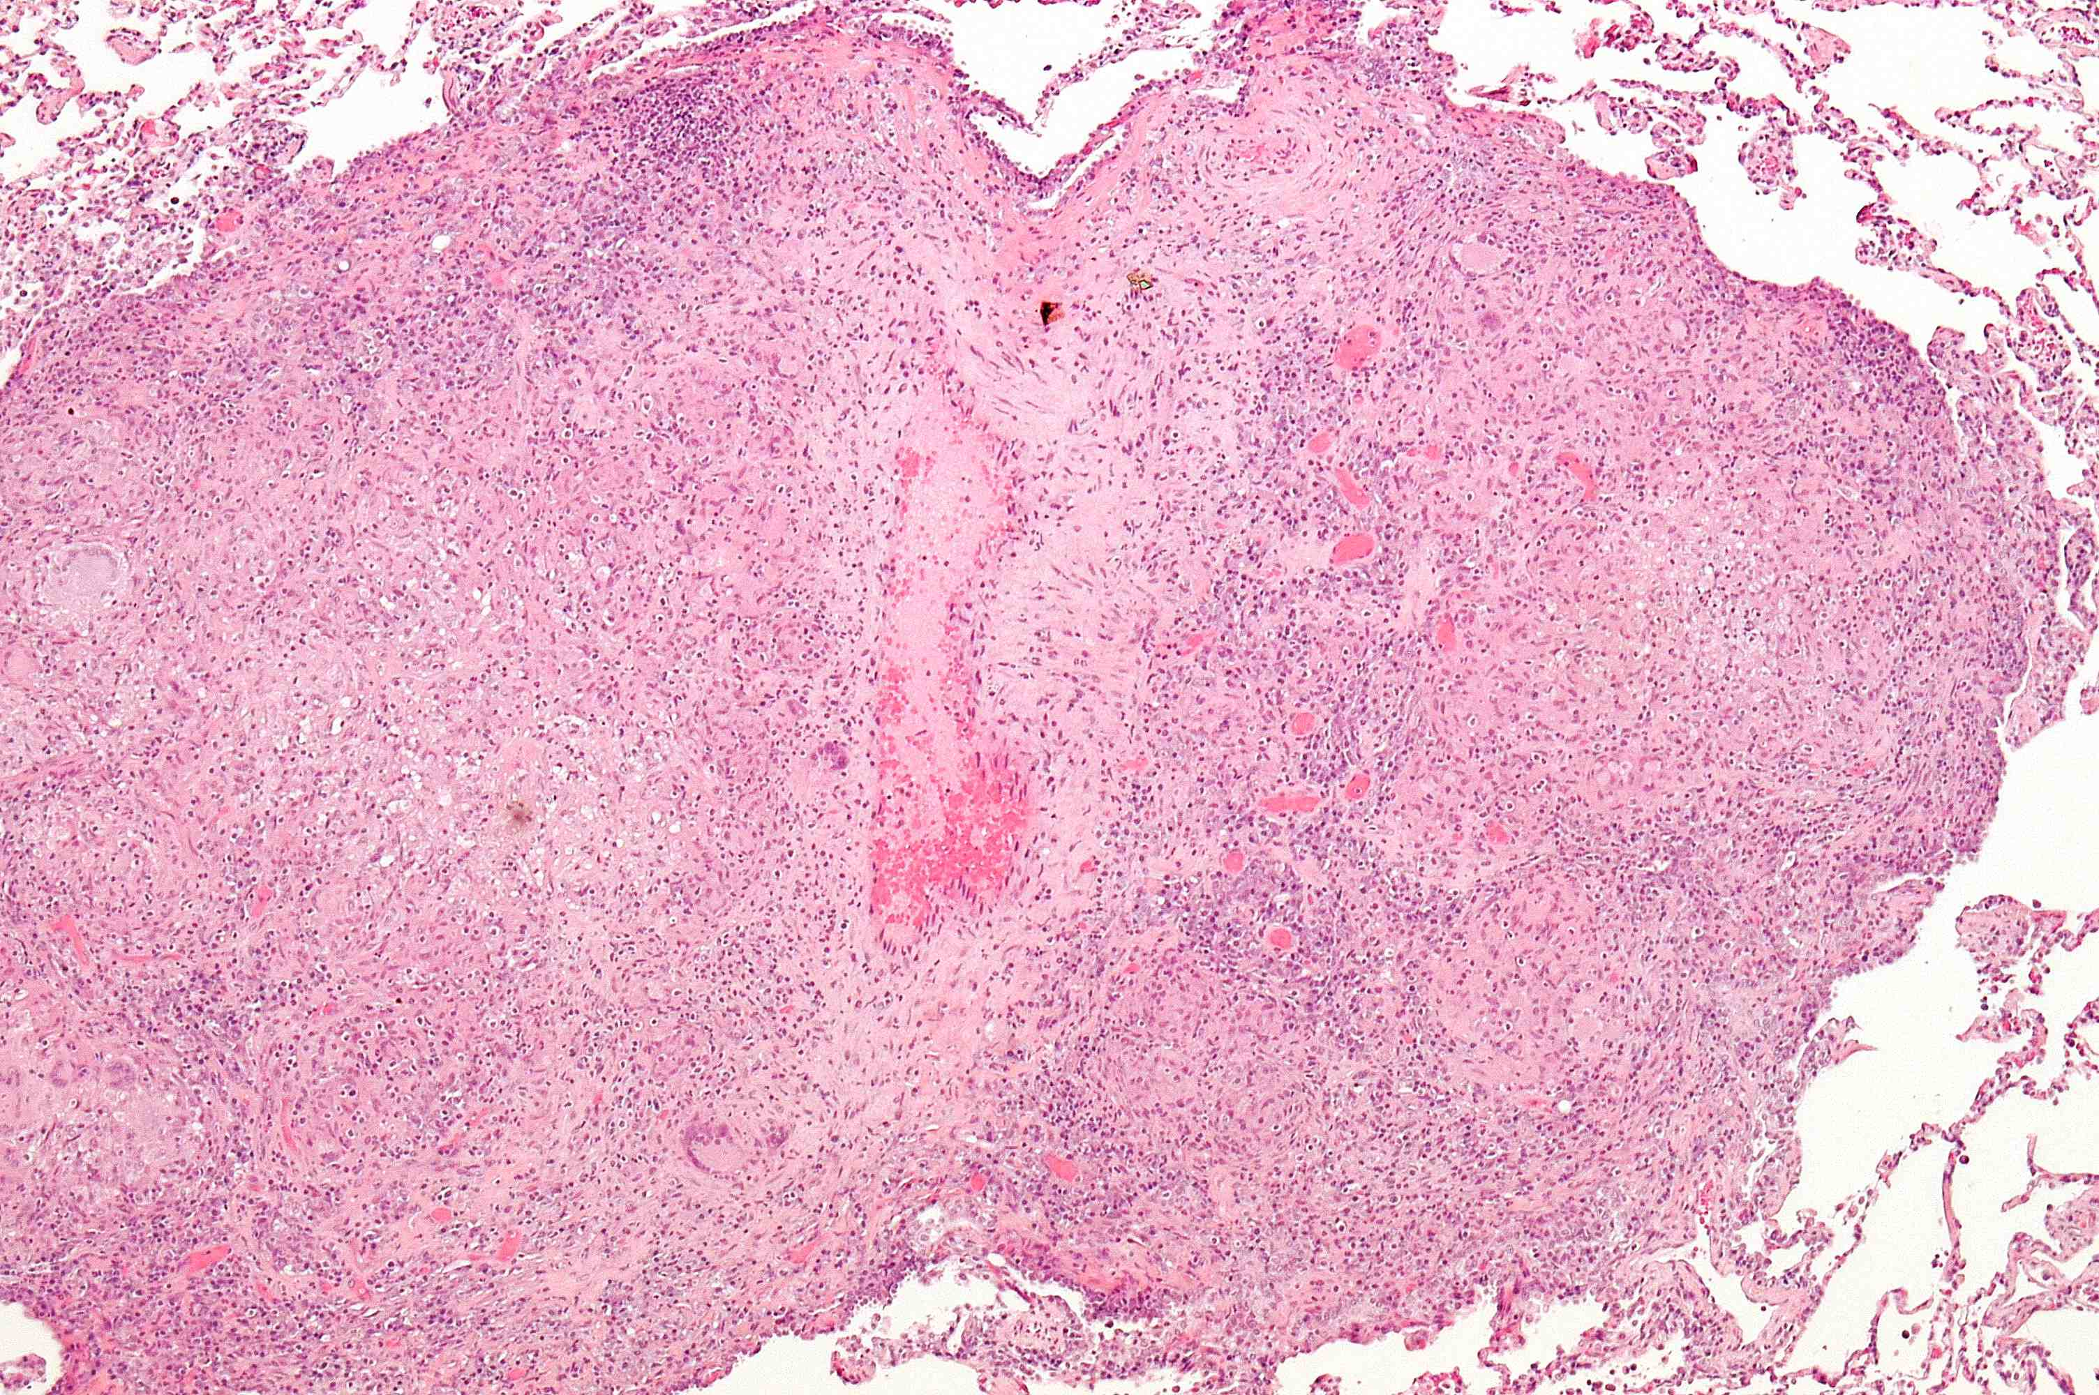
Spectrum of granulomas in macaques:
Immune and bacterial microenvironments
Caseous necrotic
Suppurative necrotic
Solid cellular
Calcified

Slide 9
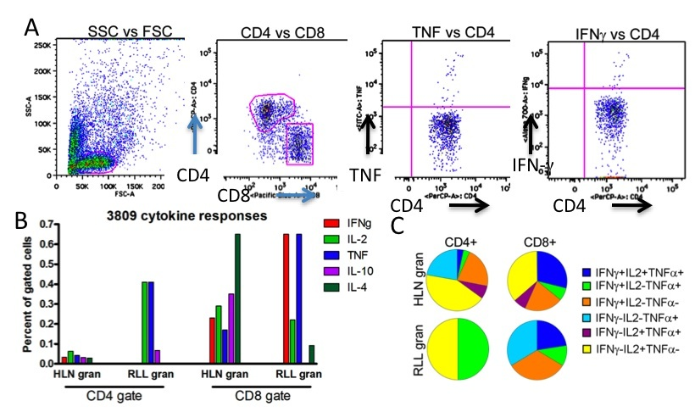
From granulomas at necropsy:
obtain data on cell types, cytokines, chemokines
in different granulomas at a specific time point
Flow cytometry, intracellular cytokine staining, boolean gating, SPICE analysis

Slide 10
TNF in the immune response to tuberculosis
Inflammatory cytokine with many functions
TNF-deficient mice very susceptible, and impaired for granuloma formation
Anti-TNF therapy in humans for inflammatory diseases leads to increased risk of reactivation TB
What functions of TNF are most important in controlling TB?
What events occur during TNF neutralization?
How and where does reactivation occur--timing?
Non-human primate model provides tools for studying latency, reactivation and events within the granuloma—
Translate information to the mathematical models for predictive studies

Slide 11
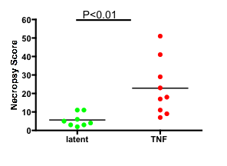
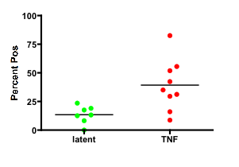
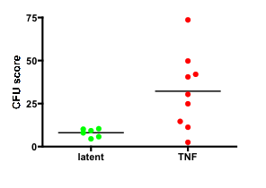
Mtb
Anti-TNF Ab
LATENT
5-8 weeks
6-20 months
p=.01
Neutralization of TNF in latent infection results in reactivation of ~70% of latent monkeys
necropsy
p=.01
Statistics: Mann-Whitney
Lin, et al, Arth Rheum 2009

Slide 12
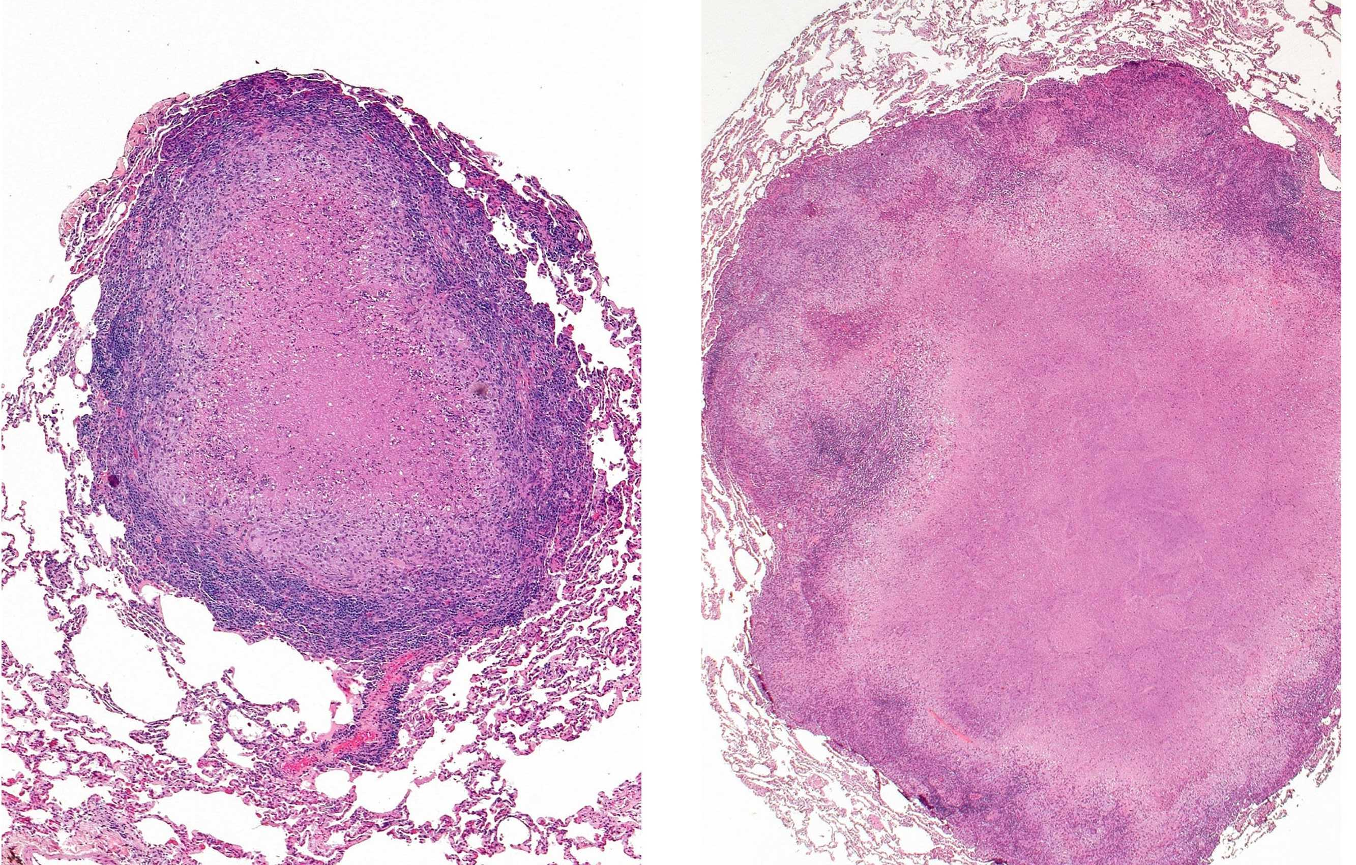
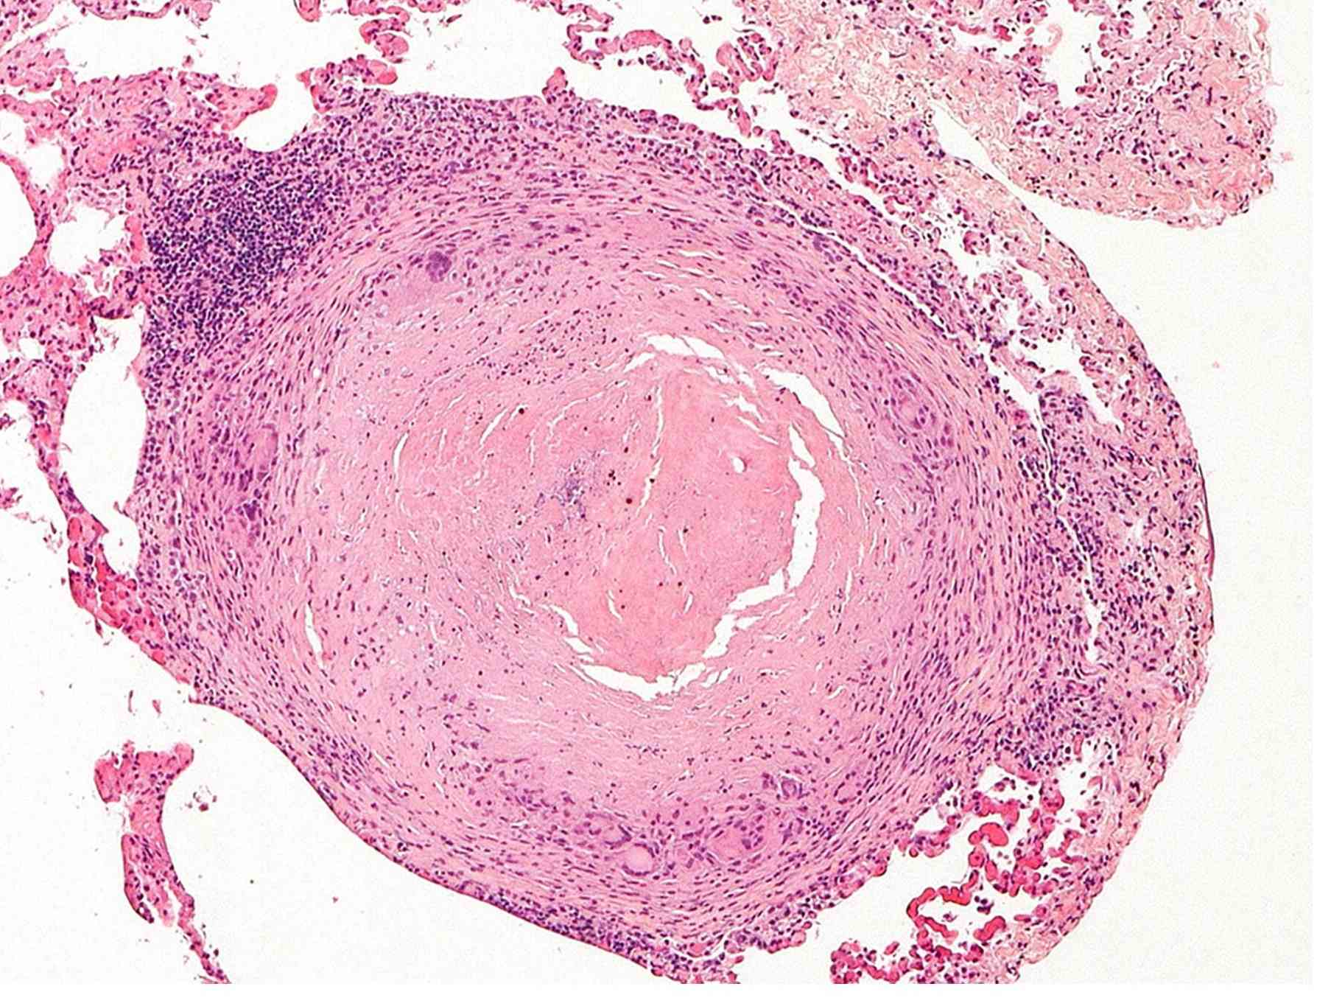
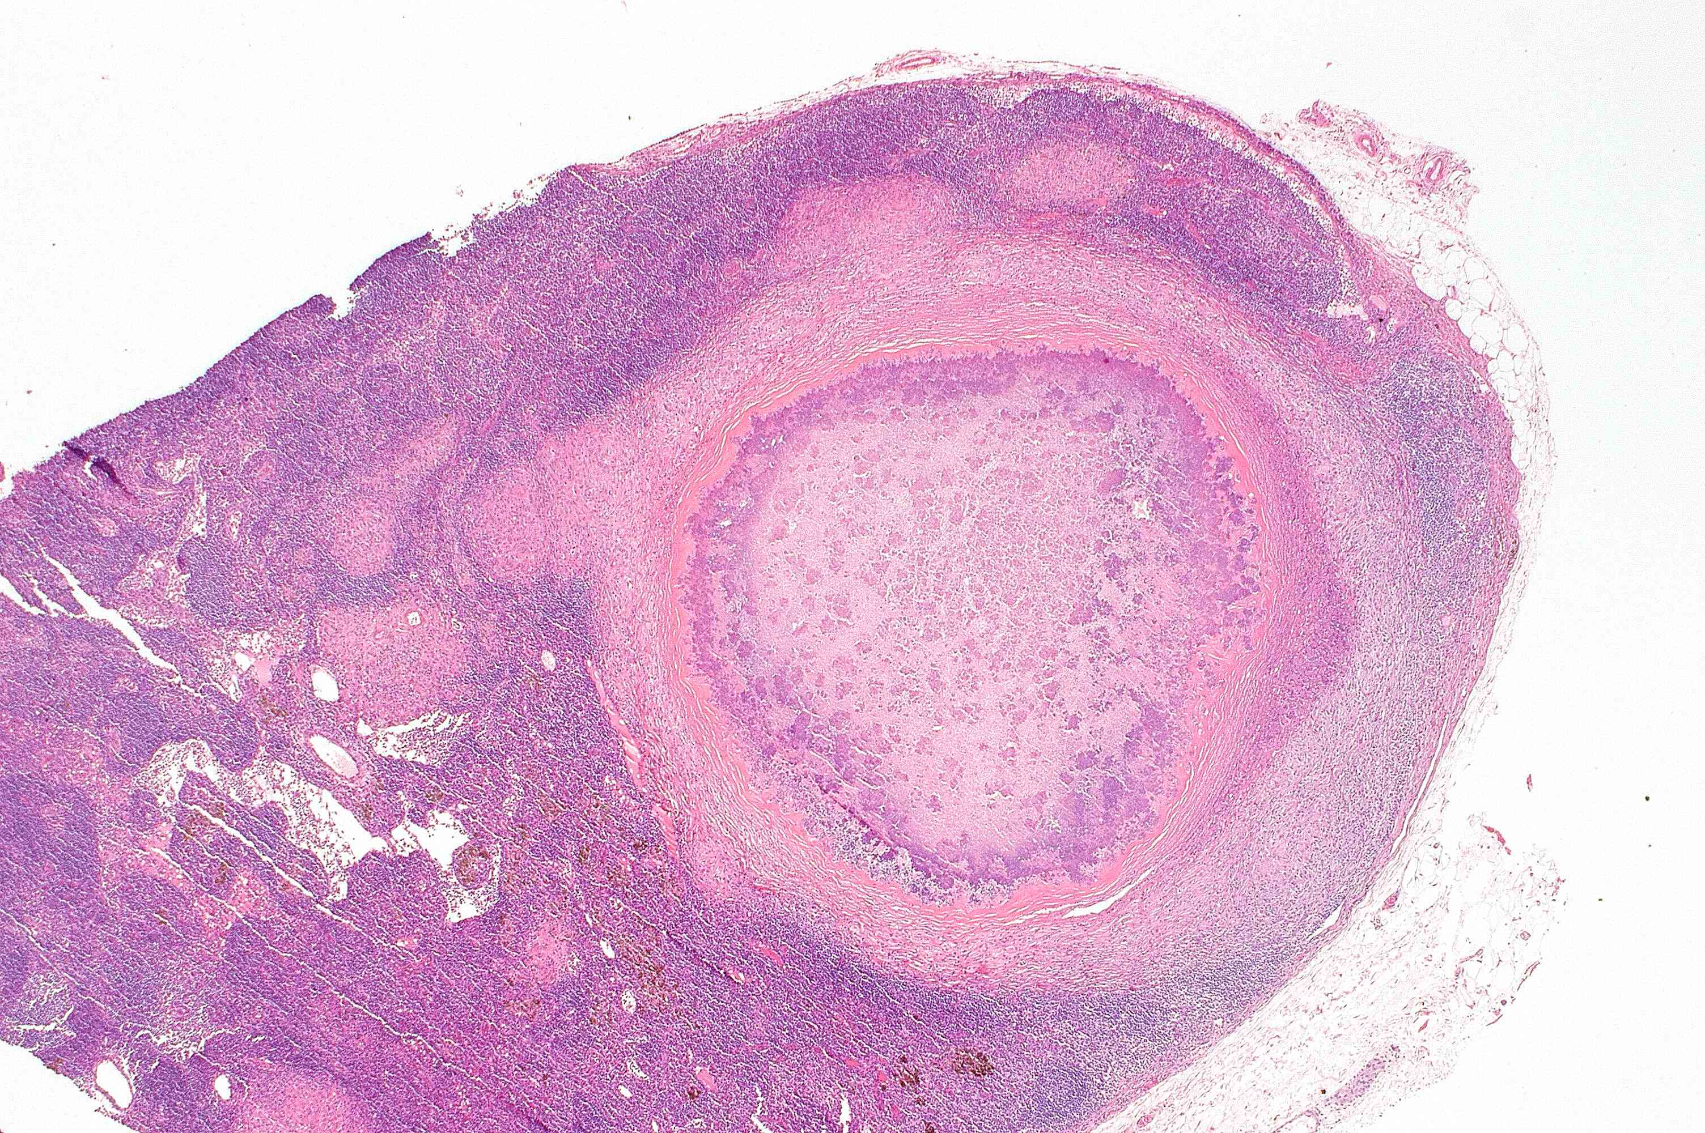
“Normal” granuloma structure in anti-TNF treated monkeys
control
Anti-TNF Ab
Acute infection
anti-TNF until
8 weeks p.i.
Carinal LN
lung
Lin, et al, Arthr Rheum 2009
Latent anti-TNF after 8 months of infection

Slide 13
What’s missing?
Dynamic studies to identify timing and sites of reactivation
Serial studies on the same monkey to determine which are susceptible to reactivation
Visualize dynamic changes in granulomas and dissemination
Whole body studies to examine different organs and sites
Solution
Real-time imaging (PET/CT) incorporated into these studies

Slide 14
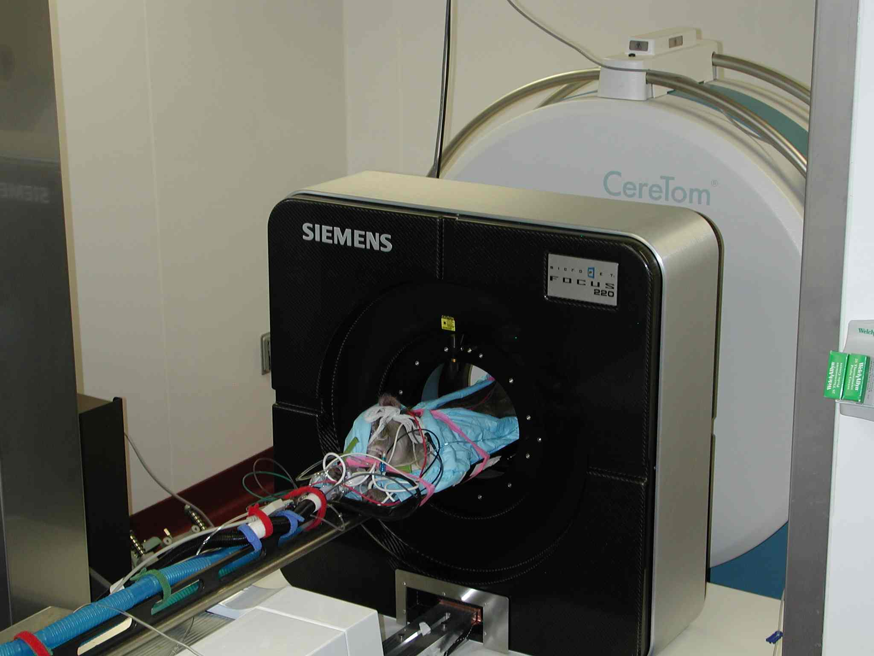
PET/CT: Imaging modality for serial tracking of lesions and disease
CT: structural map of lesions in organs
PET: functional map of lesions in organs
PET probe: specifically marks a cell with a particular property or function,
probe is tagged with a positron emitter
PET/CT in BSL3 facility
[18-F] FDG: fluorodeoxyglucose:
incorporated into metabolically active cells
marks areas of inflammation
Co-registration of PET/CT images:
structural and functional map of disease
BSL3 imaging suite
Regional Biocontainment Lab (RBL)
University of Pittsburgh

Slide 15
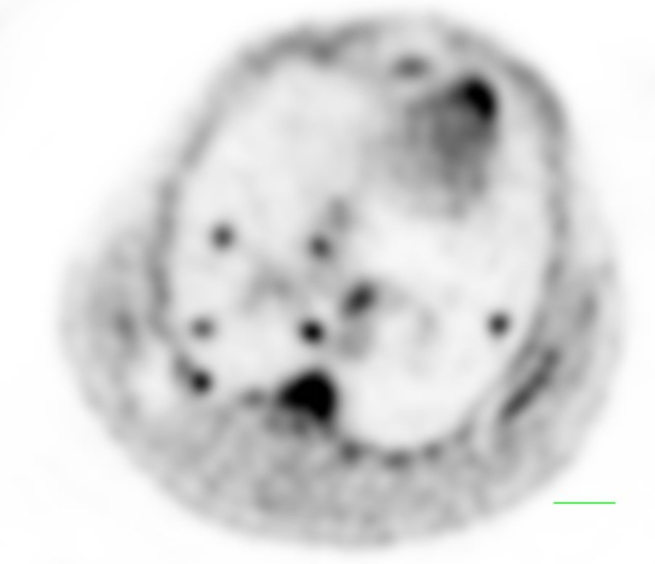
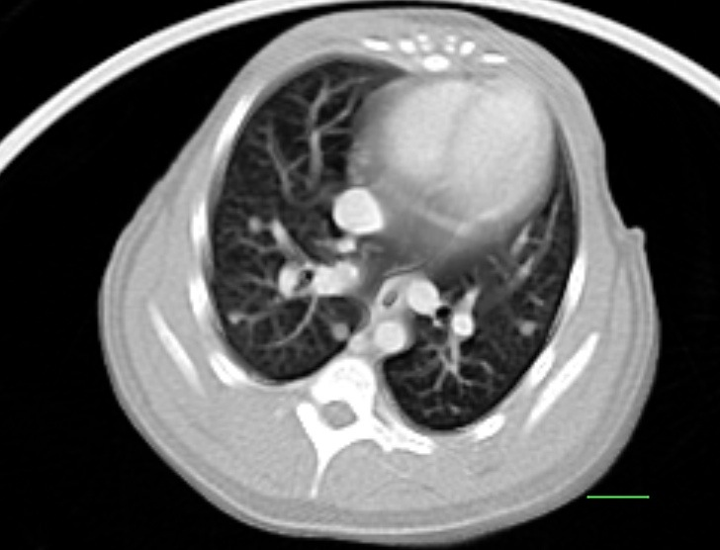
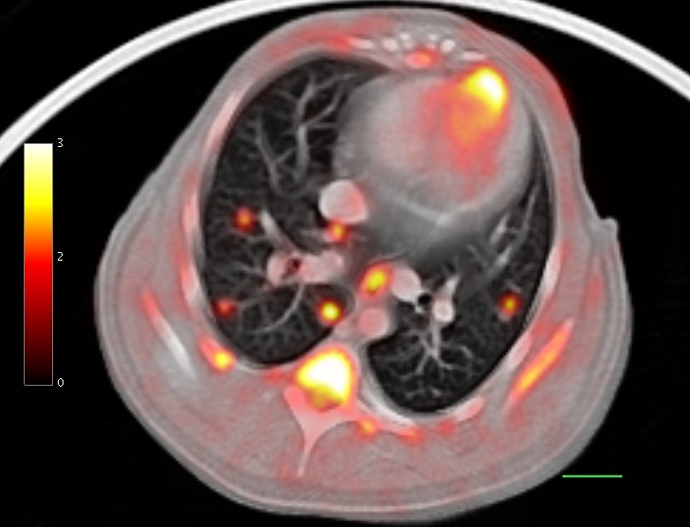

Visualization of Small (1 mm) Tuberculous Lesions
Fusion of High Resolution microPET and Diagnostic Helical CT
PET
CT
1 cm
1 cm
Tuberculosis granulomas
Fusion
SUV
University of Pittsburgh
Jonathan Carney, Brian Lopresti, JoAnne Flynn, Jim Frye, and Jamie Tomko

Slide 16
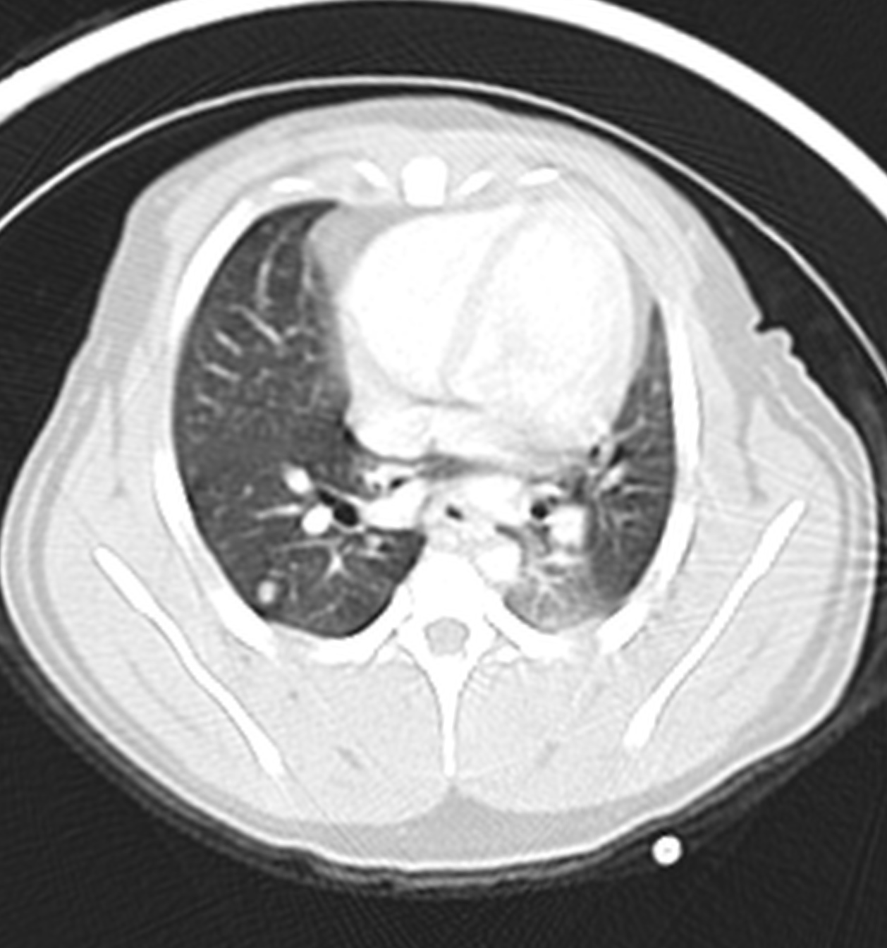
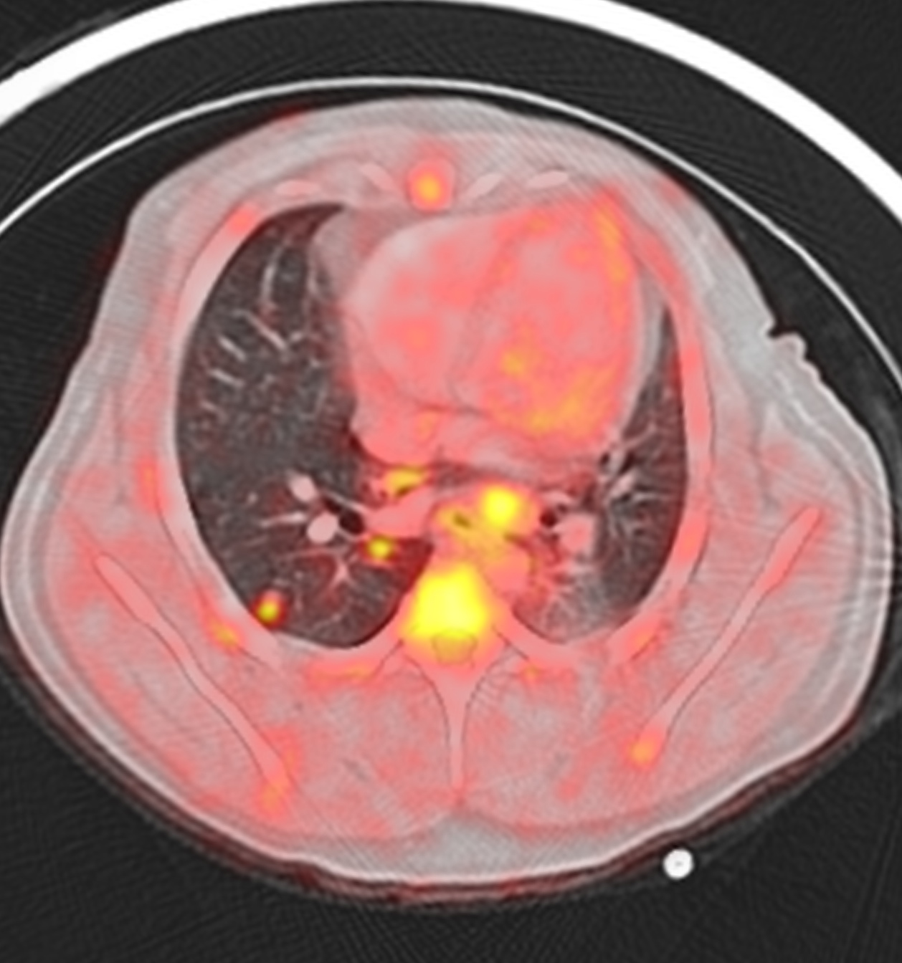
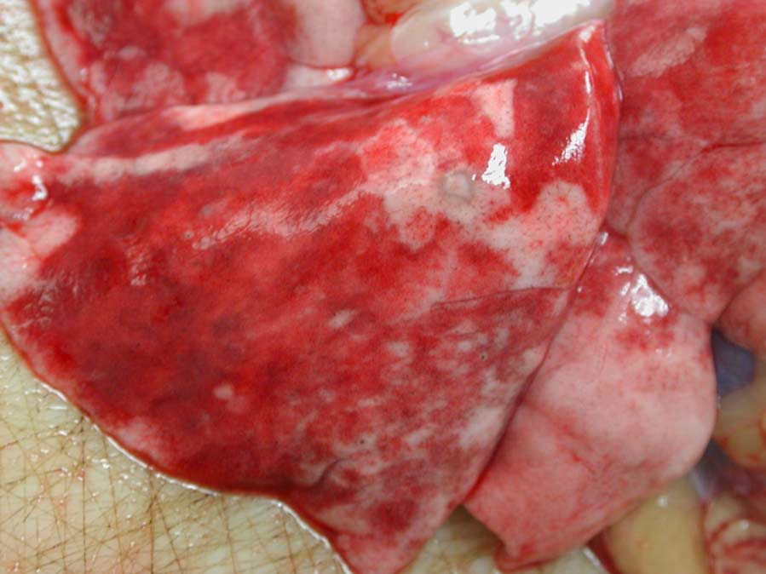
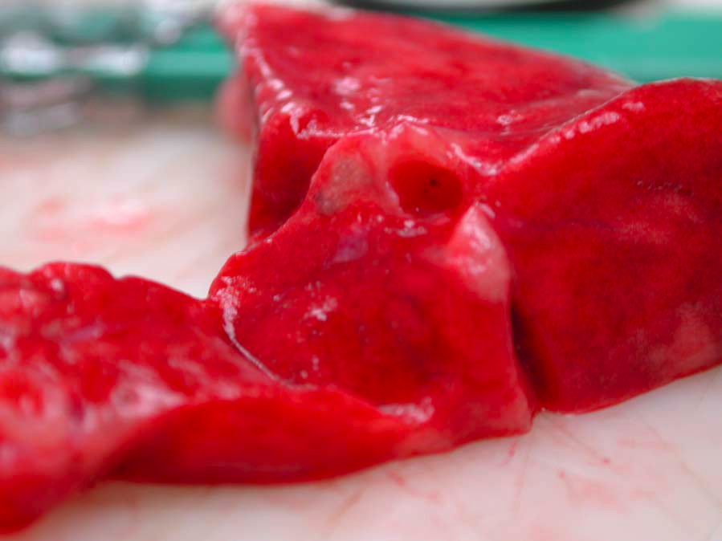
The challenge: Matching lesions from scan to lesions at necropsy
RLL 1
RLL 2
 | SUV max | size | CFU
RLL 1 | 4.6 | 2.7 mm | 7000
RLL 2 | 3.4 | 1.7 mm | 1333

Slide 17
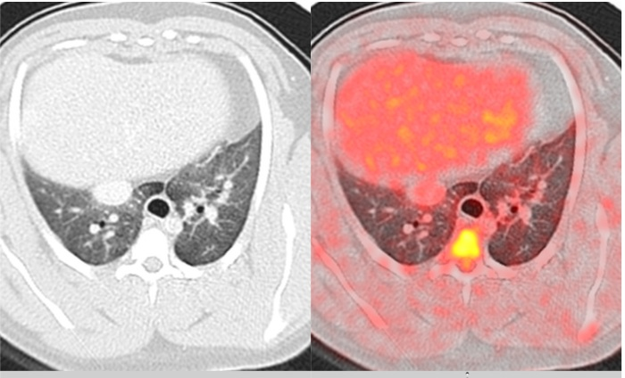
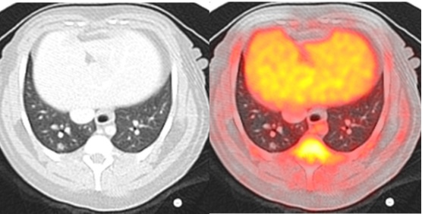
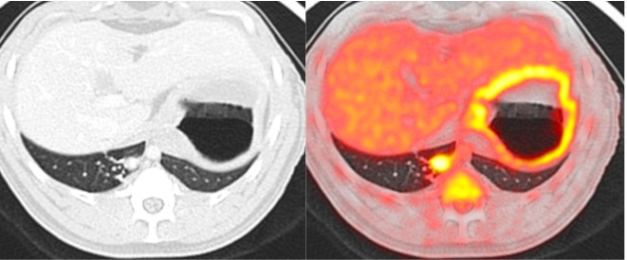
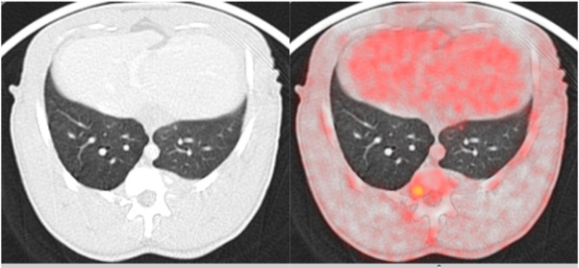
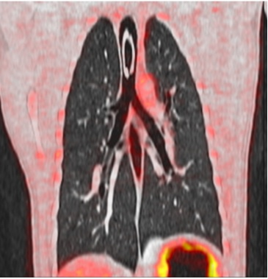
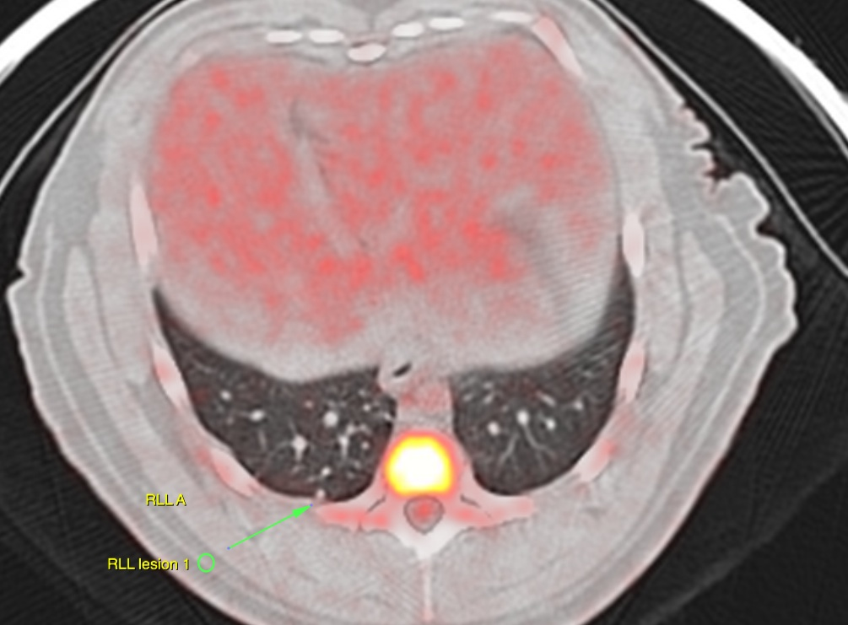
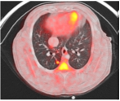
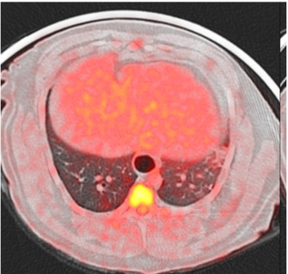
Latent TB: a spectrum of lesions in lungs (8 different monkeys)

Slide 18
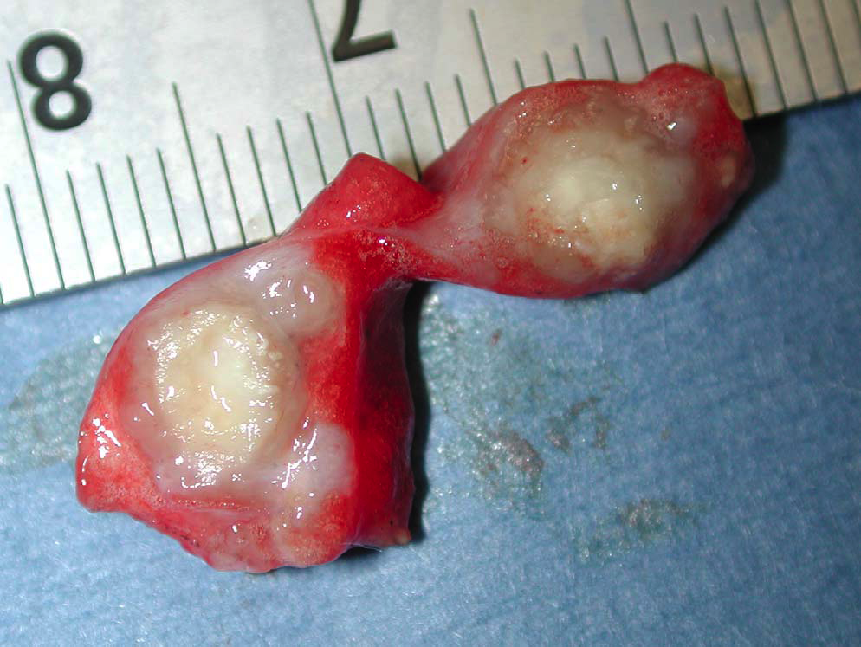
Lung lesion grows and is “hotter” following anti-TNF mediated reactivation
latent
2 Weeks anti-TNF Ab
4 Weeks anti-TNF Ab

Slide 19
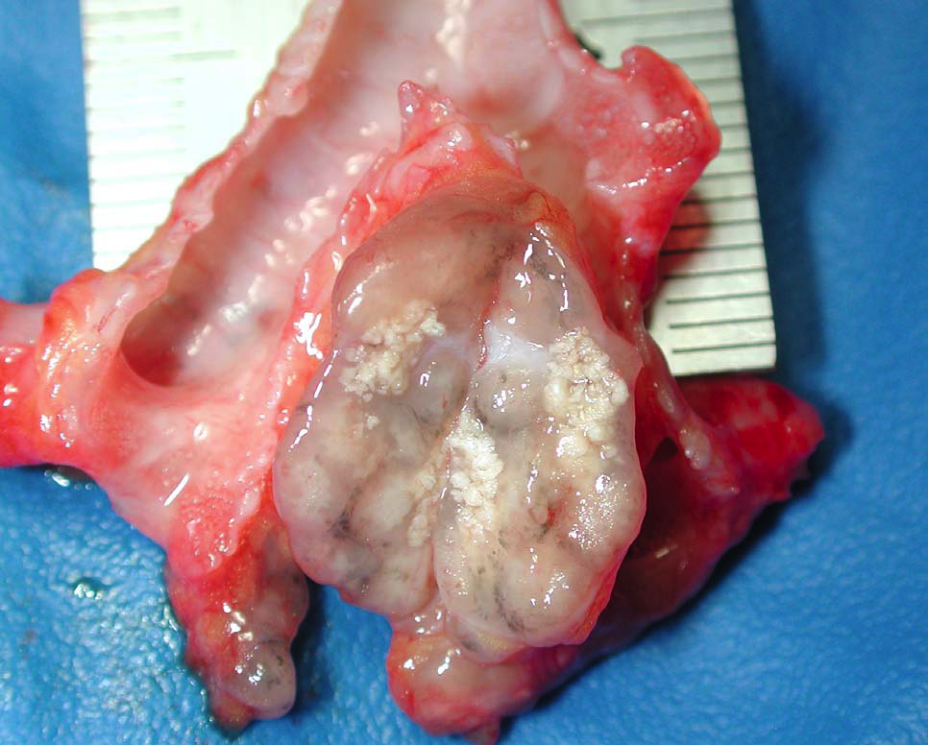
R Carinal Lymph nodes enlarge and become “hot” with anti-TNF antibody treament
latent
2 Weeks anti-TNF Ab
4 Weeks anti-TNF Ab

Slide 20
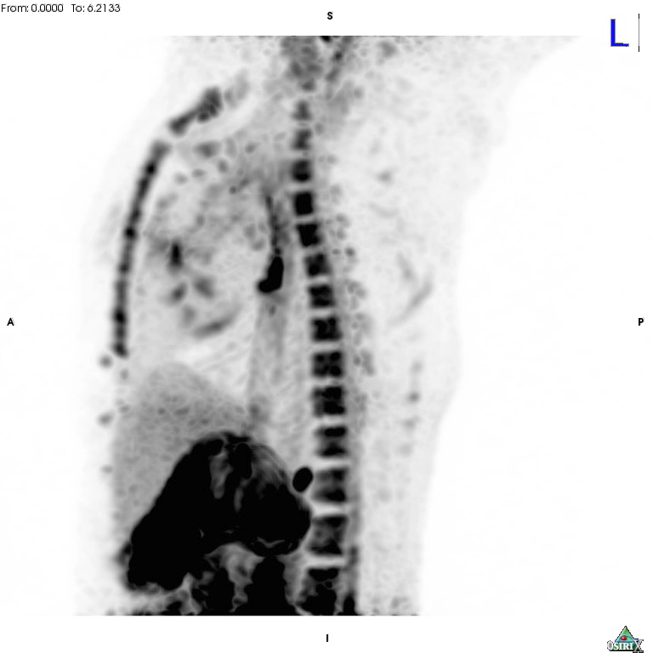
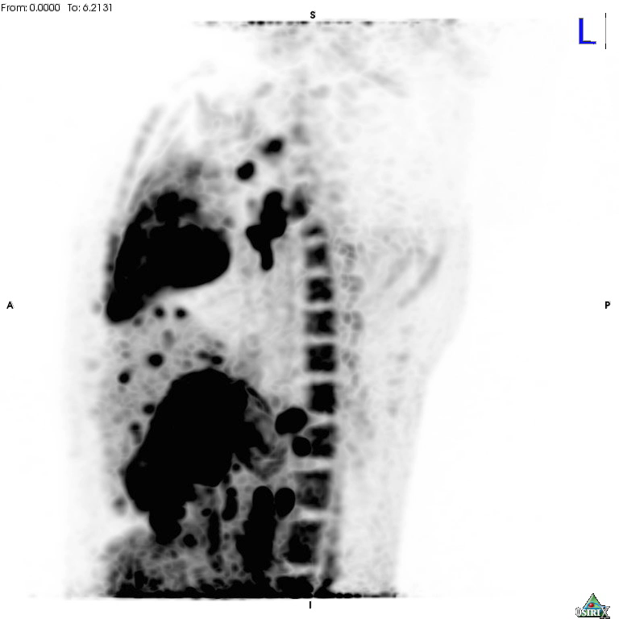
Reactivation with anti-TNF: lymph nodes and dissemination

Slide 21
Anti TNF Tx
Baseline
3 WK anti-TNF
5 WK anti-TNF
CFU score 19.9
% positive 23.8
CFU 2.2x10⁴/gm
CFU 2.6x10⁴/gm

Slide 22
Latent, anti-TNF reactivation : not all granulomas reactivate the same
R carinal (red) CFU 708
R cran HLN (blue) CFU 17500
CFU score 36.3
% positive 33%
L5 8000 CFU
L2 0 CFU

Slide 23
Using non-human primate model we can obtain:
Granulomas of varying types
stratified for bacterial numbers, stage of disease, PET/CT characteristics
Cells, cytokines, chemokines within granuloma
Structure-function relationship of different granulomas
Information on:
site of latency and reactivation
tissue and organ specific information over whole body
initial establishment of infection
factors contributing to control of acute or latent infection
factors contributing to stability and function of granuloma

Slide 24
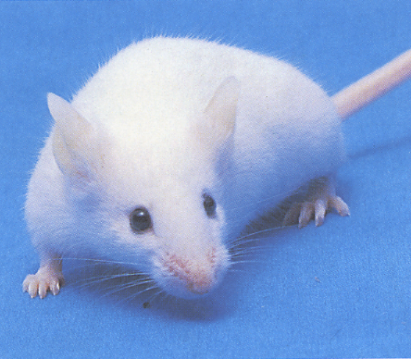
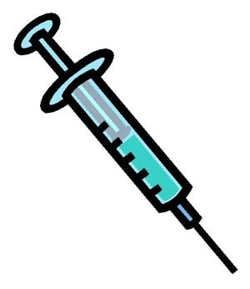
From the most complex model to a simpler one….
The murine granuloma bead model
Sepharose Beads coated with PPD (mycobacterial antigens) in a sensitized mouse
Analysis
Analysis
Days
-14
0
2
4
8
BCG 2.5x 10⁵cfu i.t.
5500 PPD beads i.v.
(Sepharose 4B beads
covalently coupled to PPD)
Kunkel Lab protocol

Slide 25
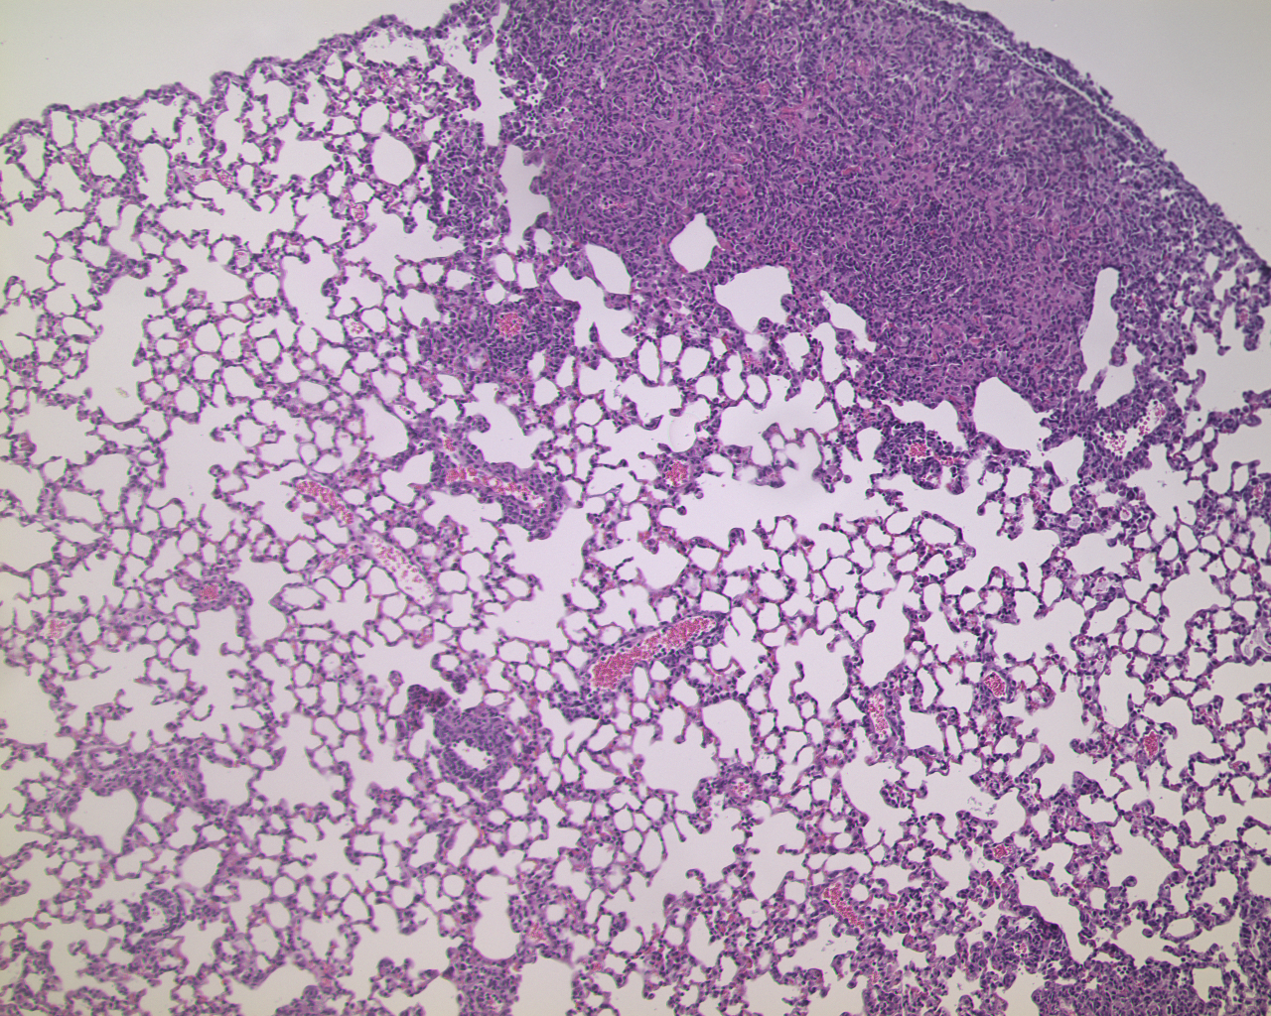
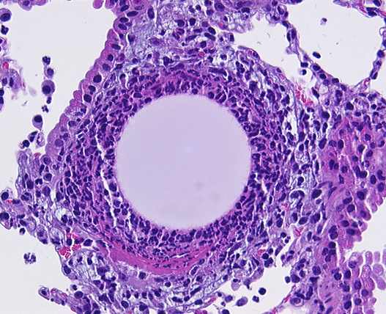
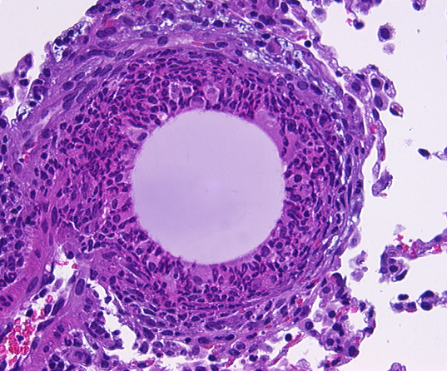
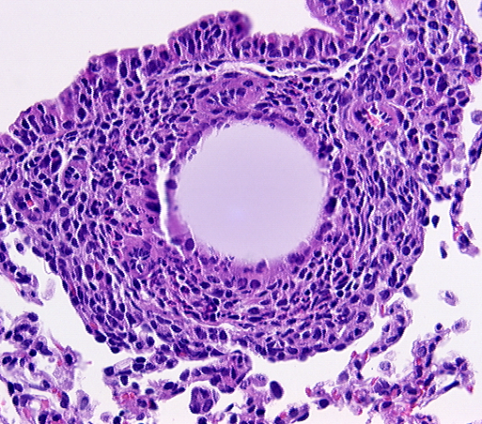
Murine bead granuloma model
• Rapid granuloma formation
(4-8 days vs 3-5 weeks)
• More structured than normal mouse granuloma
• Antigen load held steady over time
• Easy to extract granuloma and obtain cells
Murine M.tb granuloma
Immune cells form granuloma around bead
Day 2
Day 4
Day 8
-Mice are genetically identical—results are easily replicated
-Mouse can be manipulated at a detailed level
(genetic, antibodies for neutralization, depletion)
-Obtain more mechanistic data than in NHP
Kunkel Lab

Slide 26
Uses of in vivo data in model construction and validation
Combination of models to obtain data for constructing models
Dynamic and detailed data on granuloma formation and reactivation in multiple organs and multiple sites in tissue
Obtain granulomas for detailed characterization (cells, cytokines)
Manipulation of mouse and non-human primate to identify important factors
Use models to explore potential functions of identified factors

Slide 27
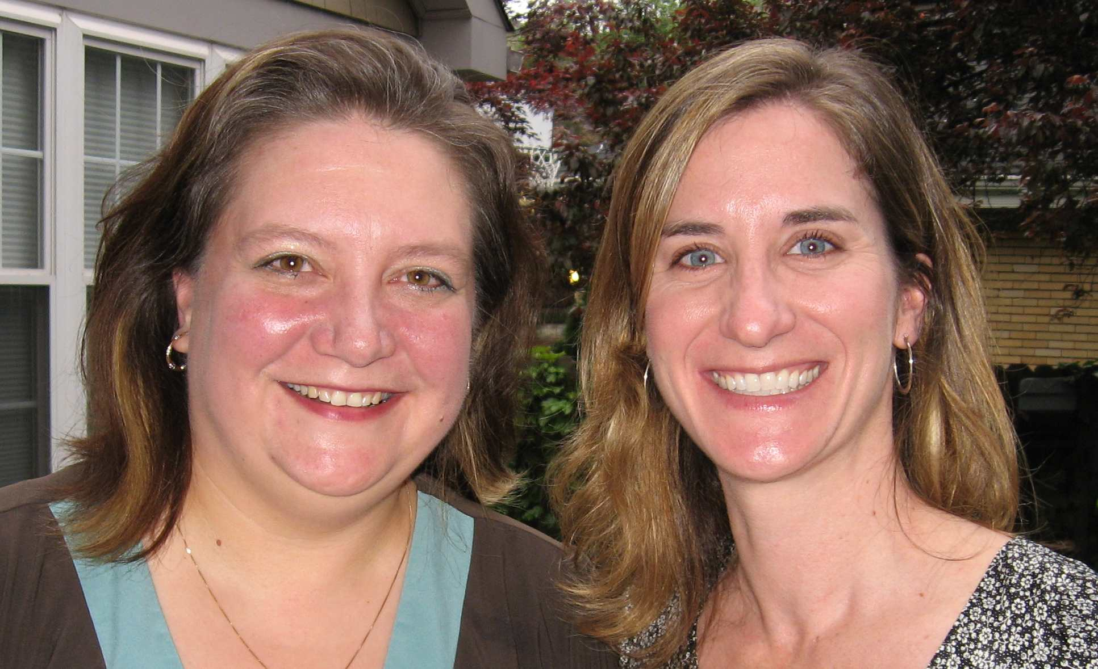
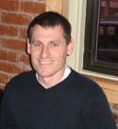

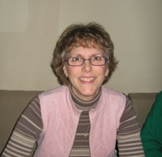
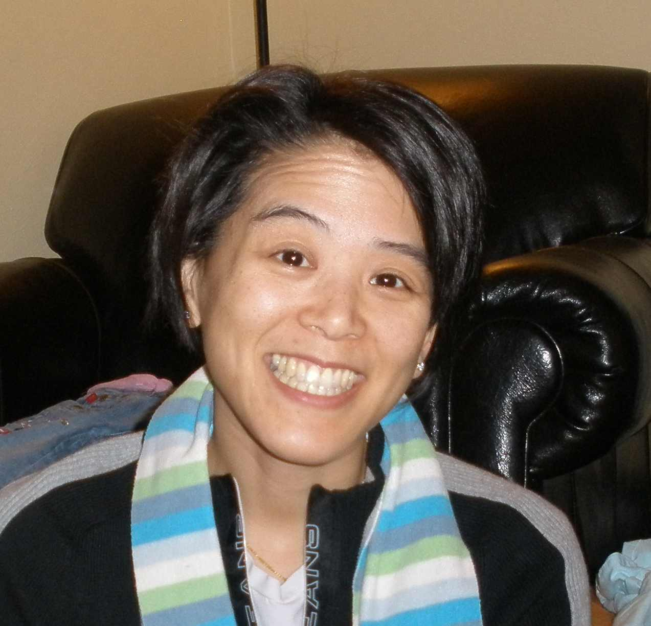
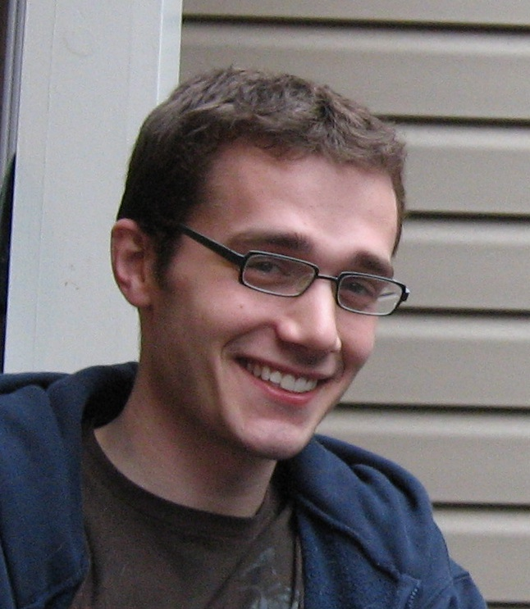
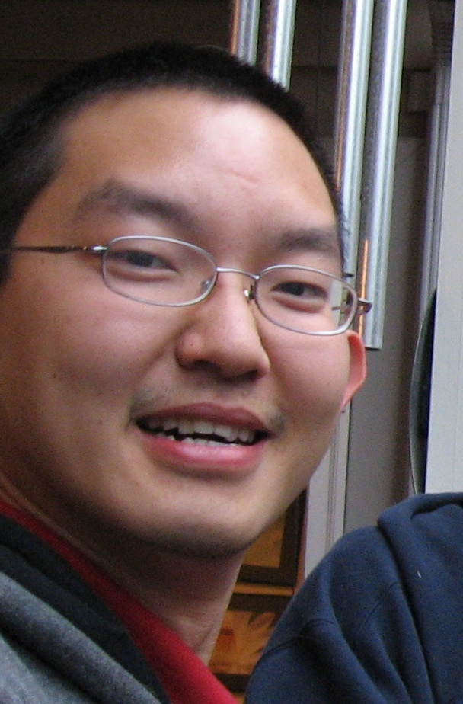
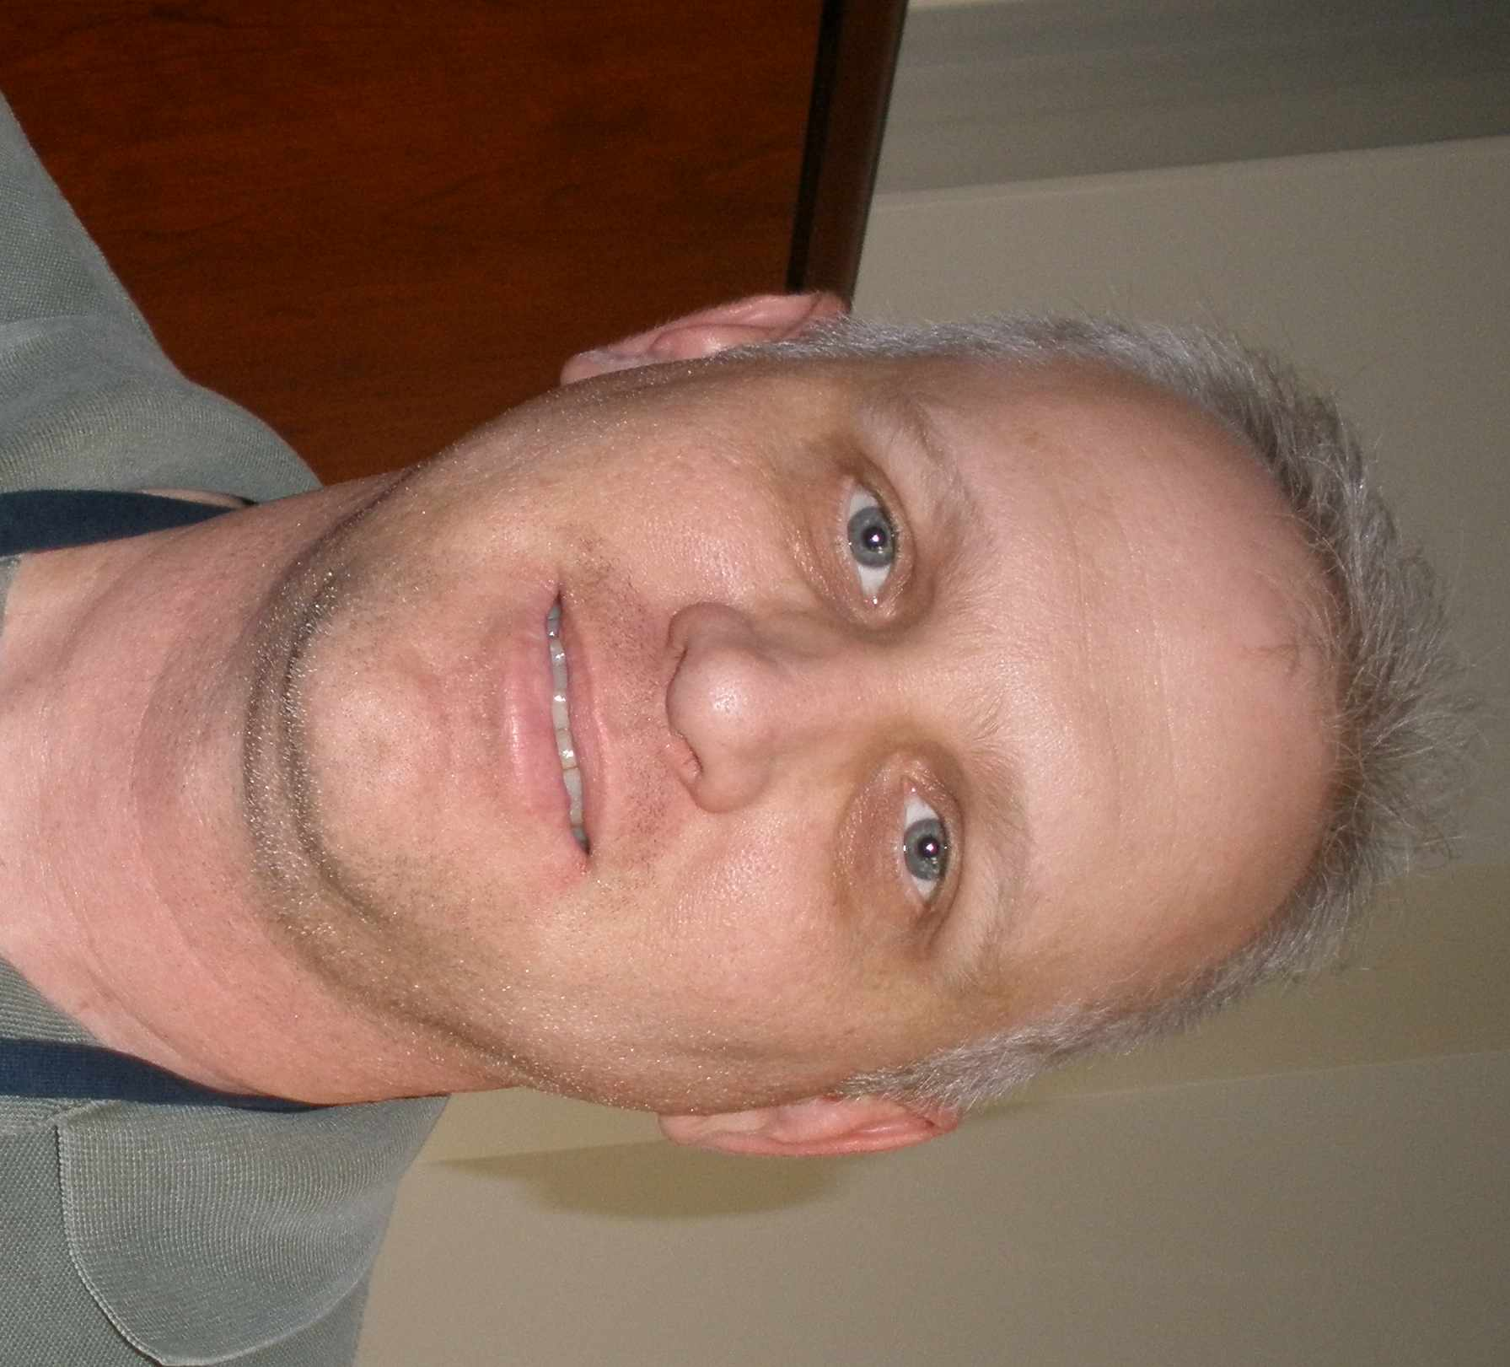








Flynn Lab 2009
Carolyn Bigbee
Mark Rodgers
Melanie O’Malley
Kelly Wyatt
Cathy Cochran
Angie Green
Amy Myers
Ling Lin
Jim Frye
Olabisi Ojo
Collin Diedrich
Jia Yao Phuah
Le’Kneitah Smith
Thorbjorg Einarsdottir
Dan Fillmore
Josh Mattila
Jen Kerr
Chuck Scanga
Paul Johnston
Jaime Tomko

Slide 28



COLLABORATORS
University of Pittsburgh School of Medicine
Brian Lopresti
Chris Janssen
Douglas Young (Imperial College)
Clifton Barry III, NIH
Robert Wilkinson
Members of the GC11 consortium
Keith Reimann, Harvard
Ed Klein
Eoin Carney
Teresa Coleman
FUNDING
NIH/NIAID (R33), NIH/NHLBI
Bill and Melinda Gates Foundation
Wellcome Trust
University of Michigan
Kirschner Lab
Linderman Lab
Kunkel Lab

