Slide 1
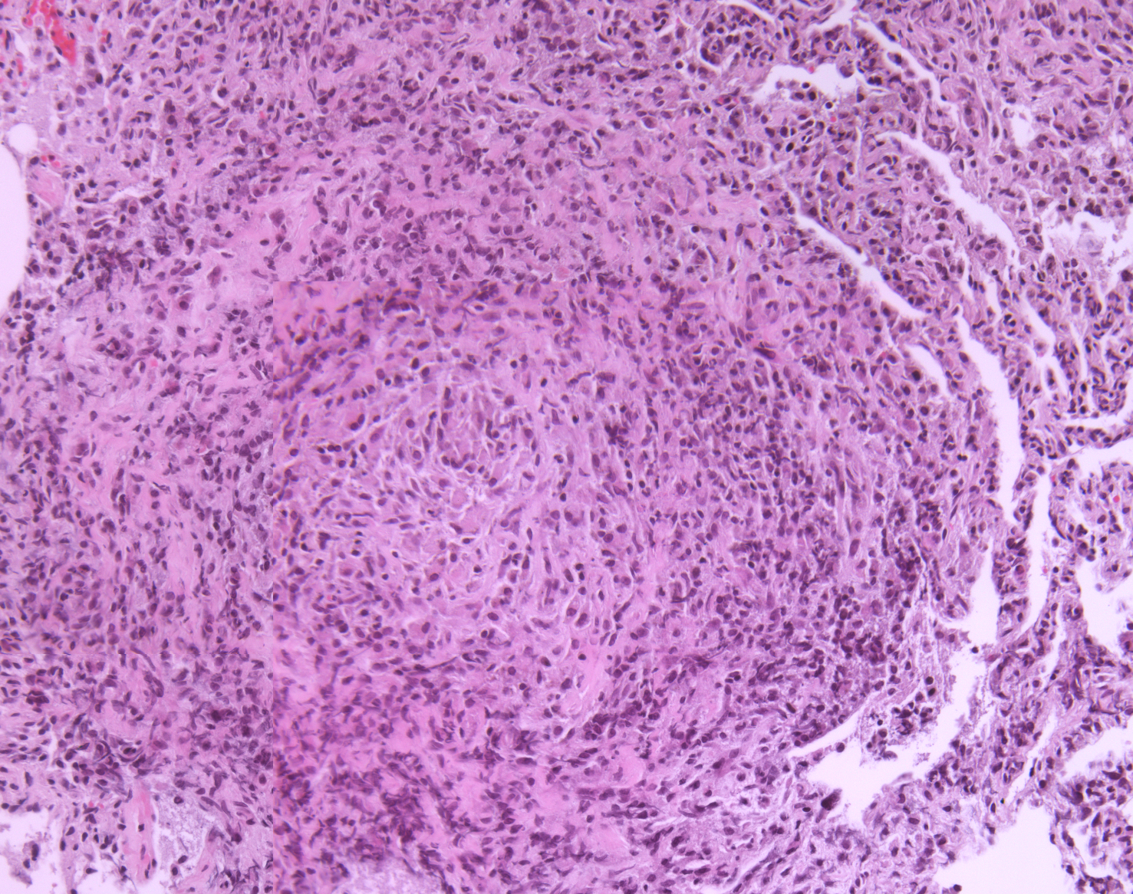
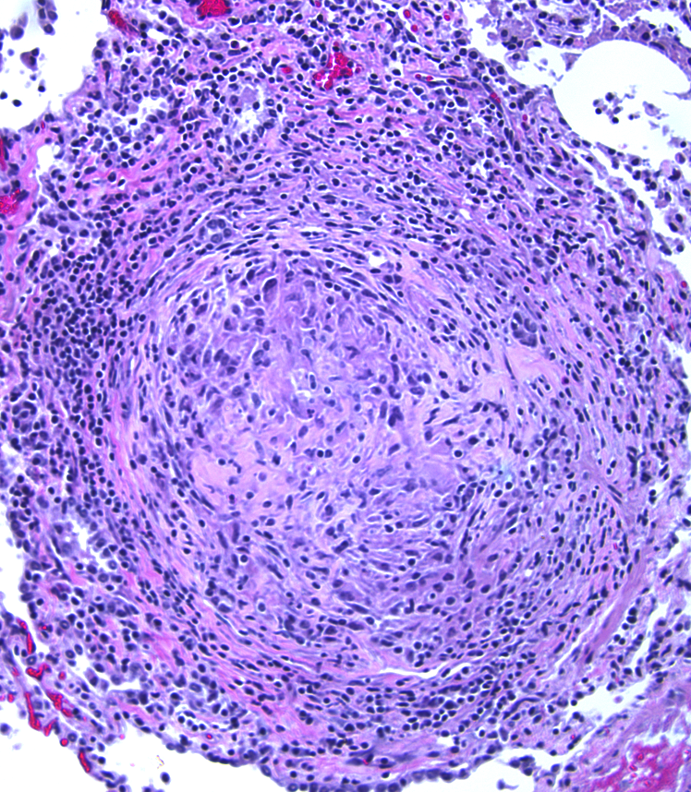
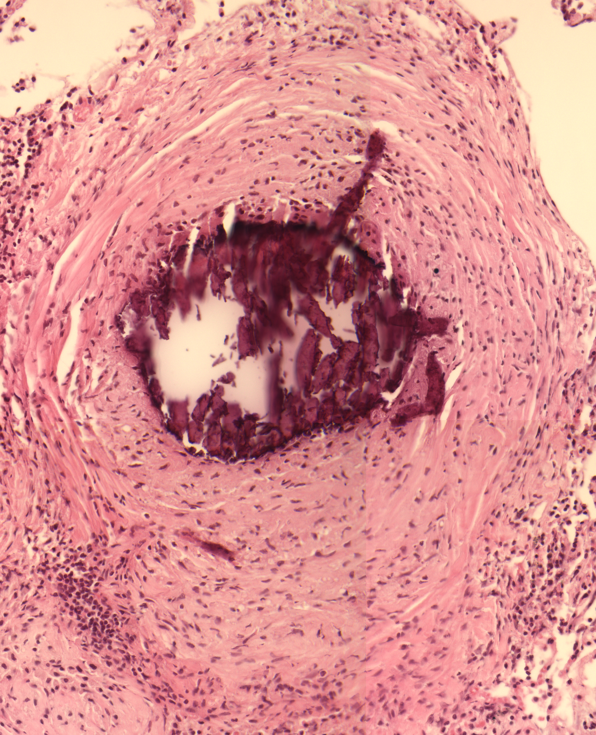
Notes:
H and E stains. If you do the animation, in order the granulomas are: active disease (non necrotic), one month drug treatment (healing), two month drug treatment (fibrocalcific)

Slide 2
Notes:
Summary of types of granulomas found per each animal. This was just a mini rotation project at the time, so I only did one monkey per group. There were four granulomas for active control, 21 for one month, and seven for two month.

Slide 3
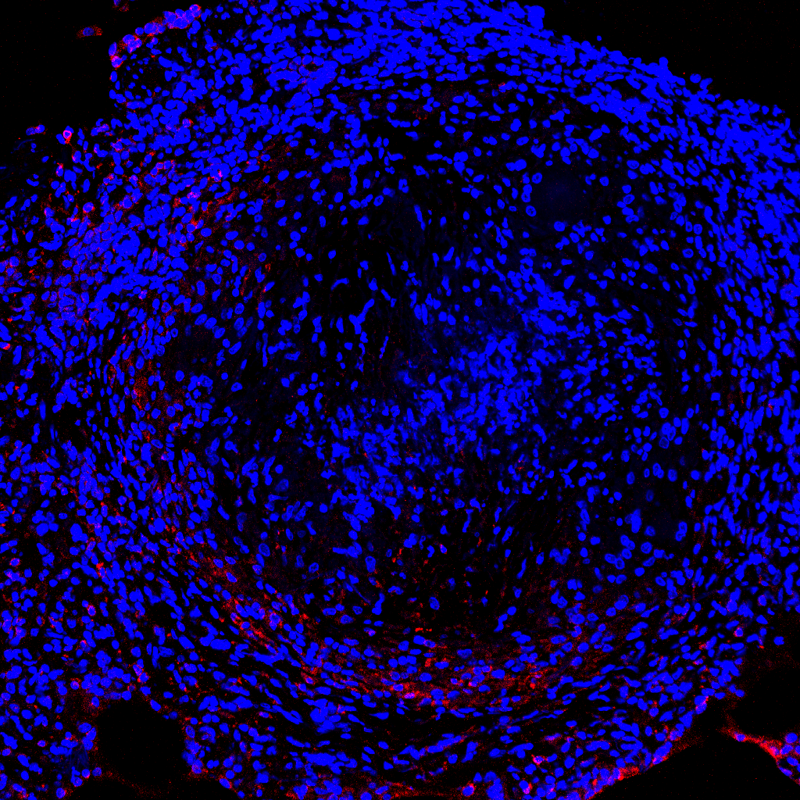
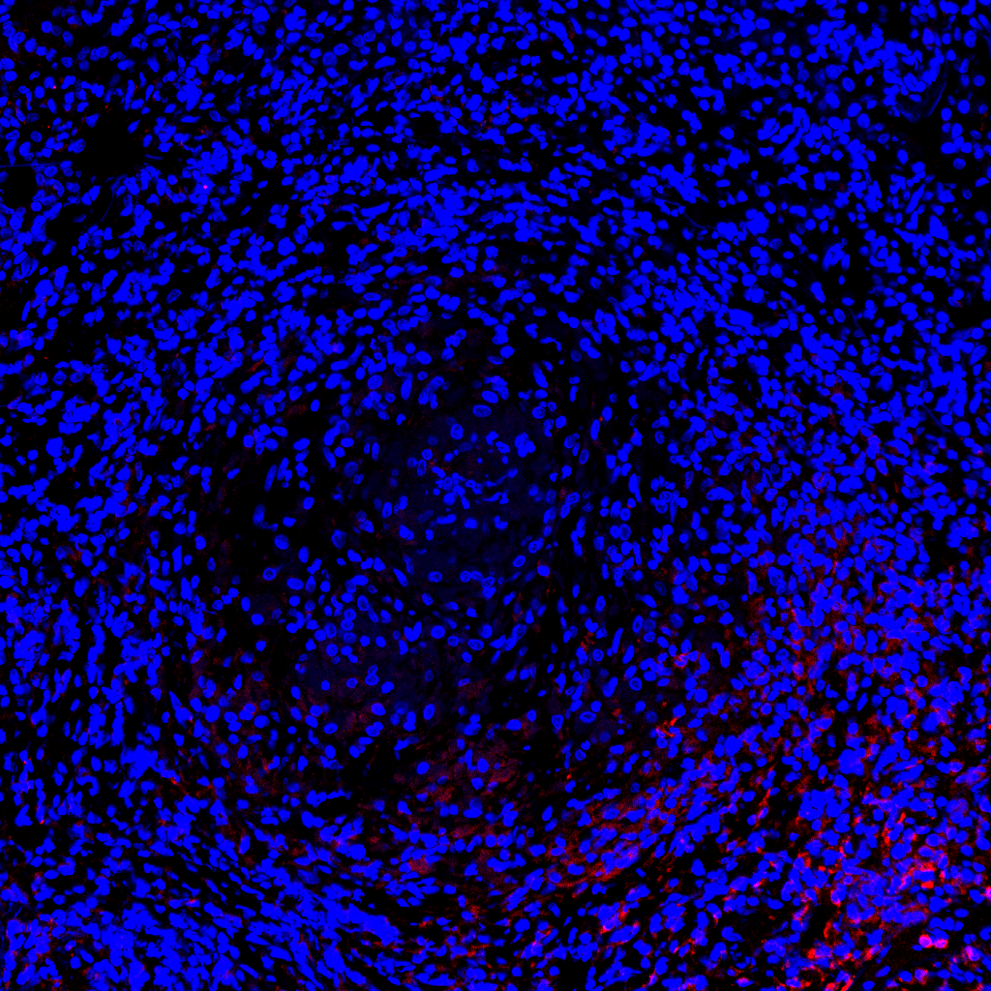
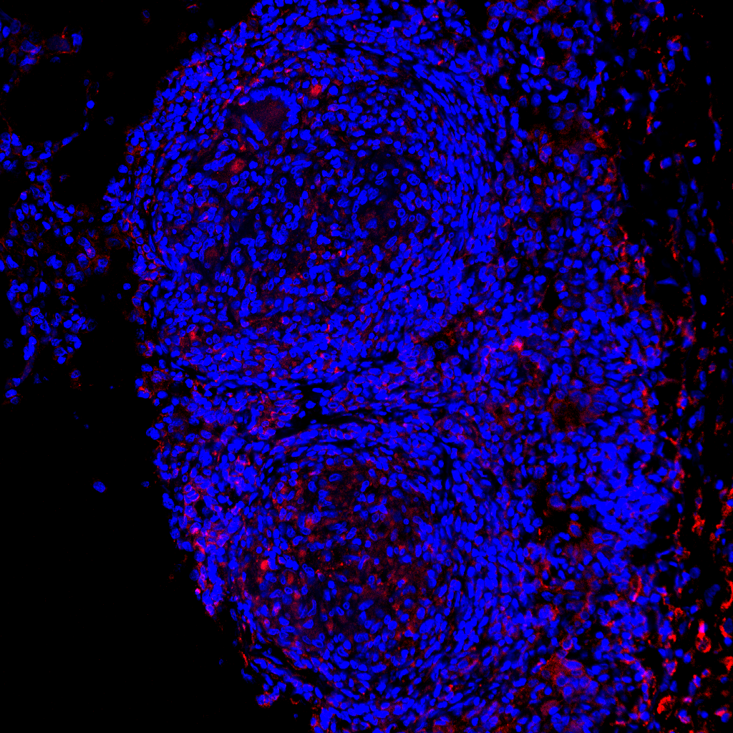
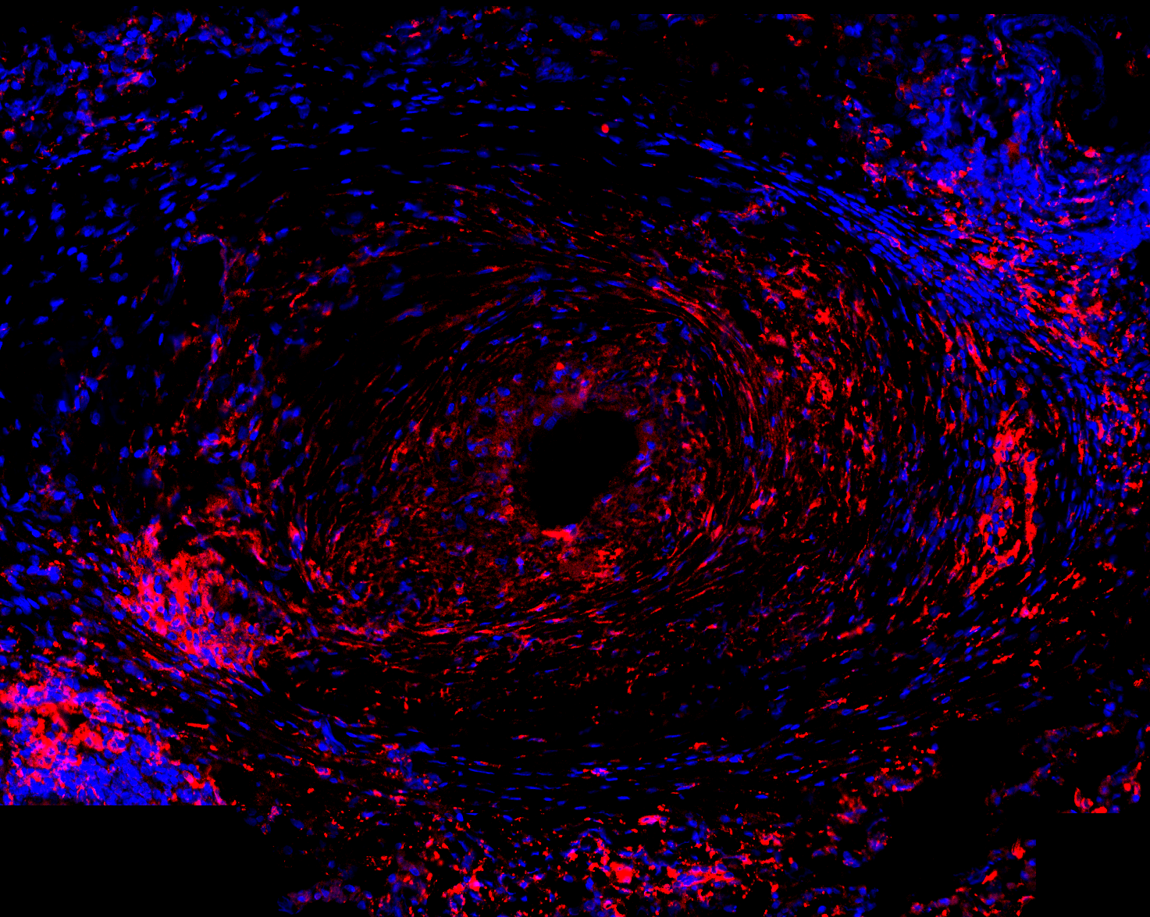
DAPI
CD163
Notes:
CD163 is red
Dapi is blue
Caseous
Non-necrotic
Healing
fibrocalcific

Slide 4
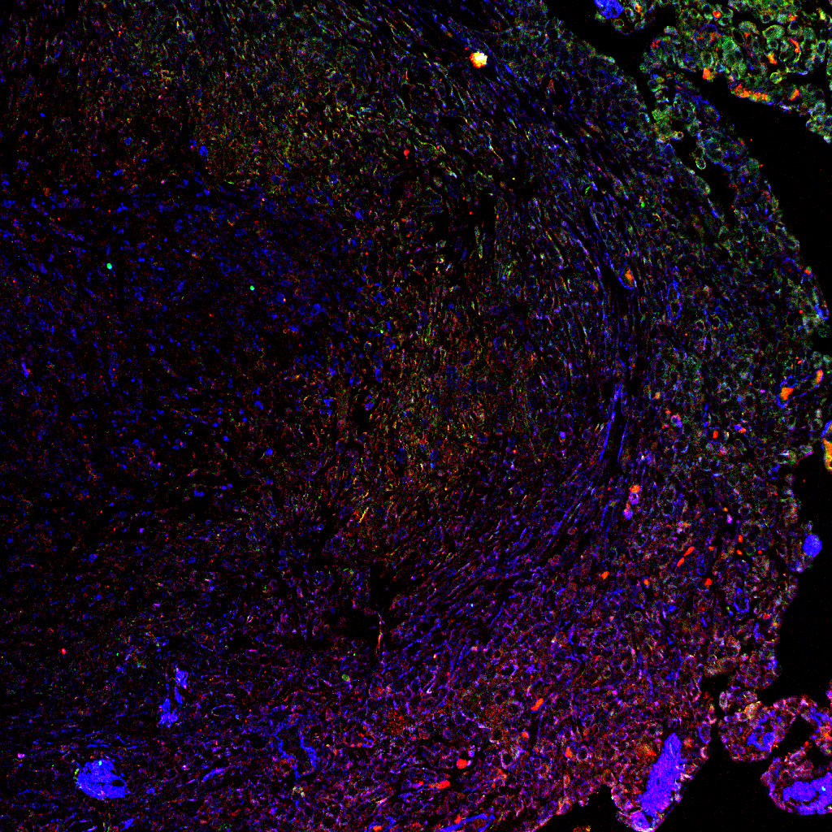
aSMA
Active TGFb
Latent TGFb
Notes:
Caseous TGFß and aSMA pictures
Blue is aSMA
Red is active TGFb
Green is latent TGFb

Slide 5
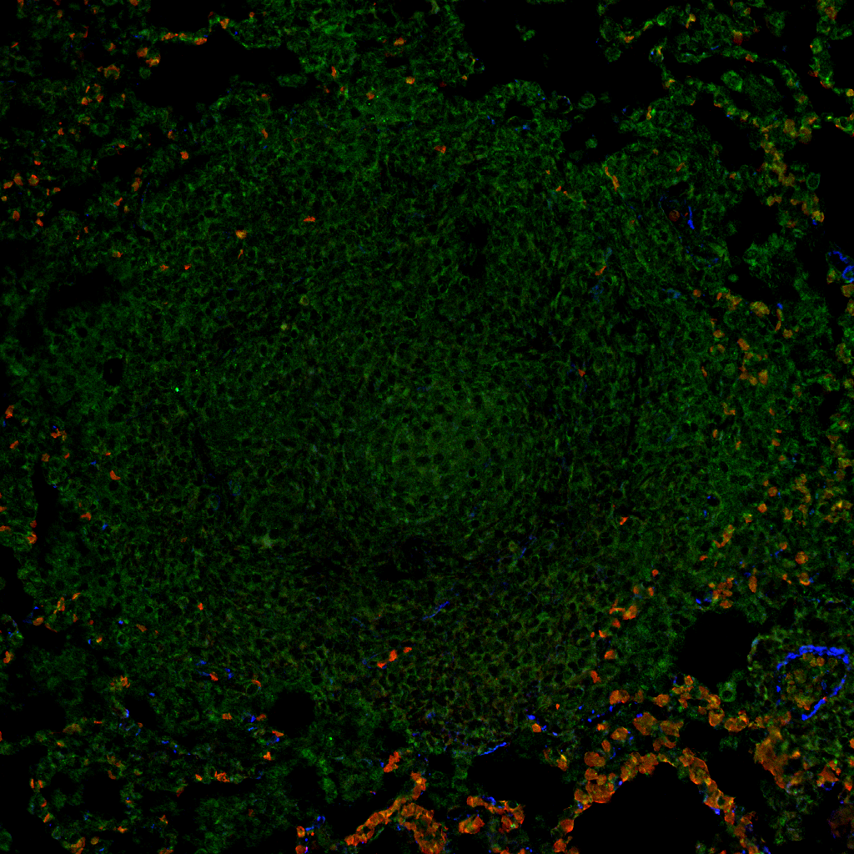
aSMA
Active TGFb
Latent TGFb
Notes:
Non-necrotizing TGFß and aSMA pictures
Blue is aSMA
Red is active TGFb
Green is latent TGFb

Slide 6
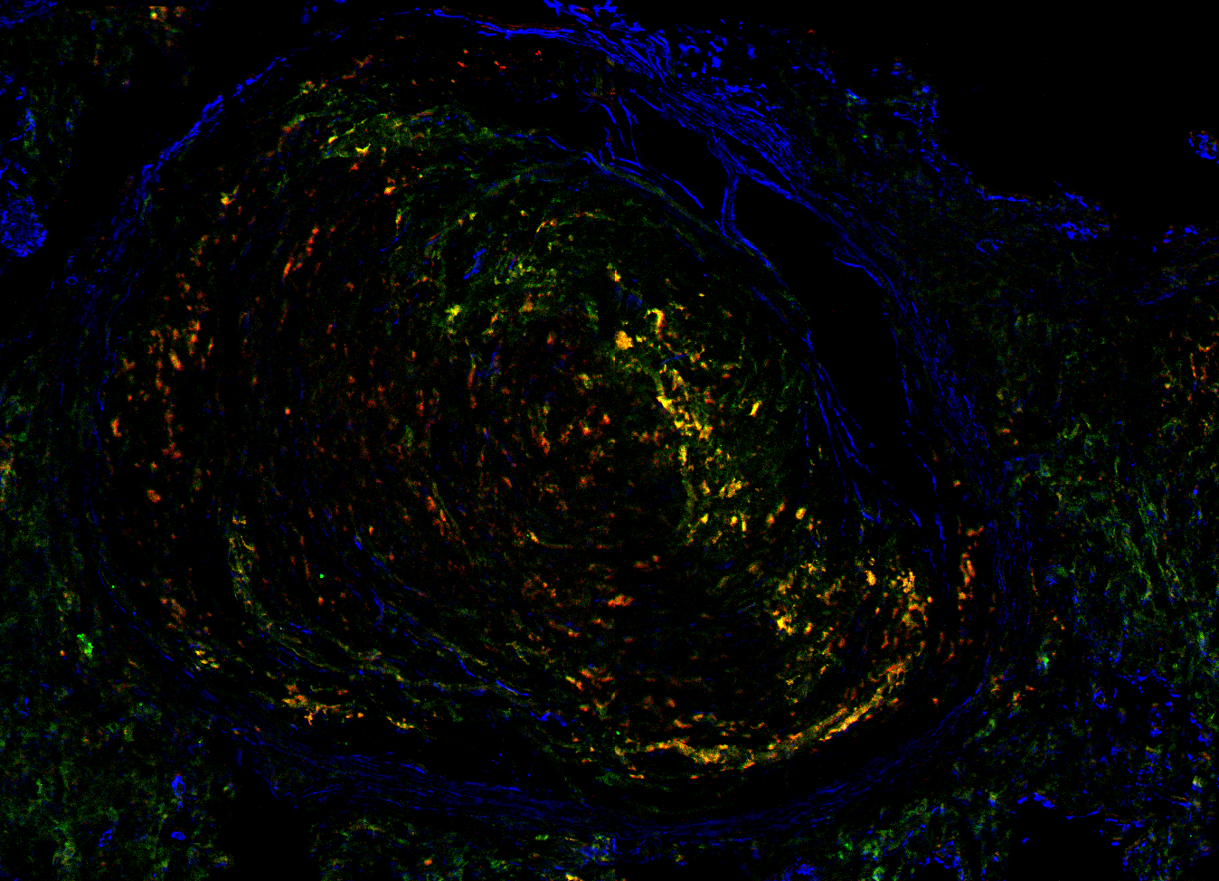
aSMA
Active TGFb
Latent TGFb
Notes:
Late healing TGFß and aSMA
Blue is aSMA
Red is active TGFb
Green is latent TGFb

Slide 7
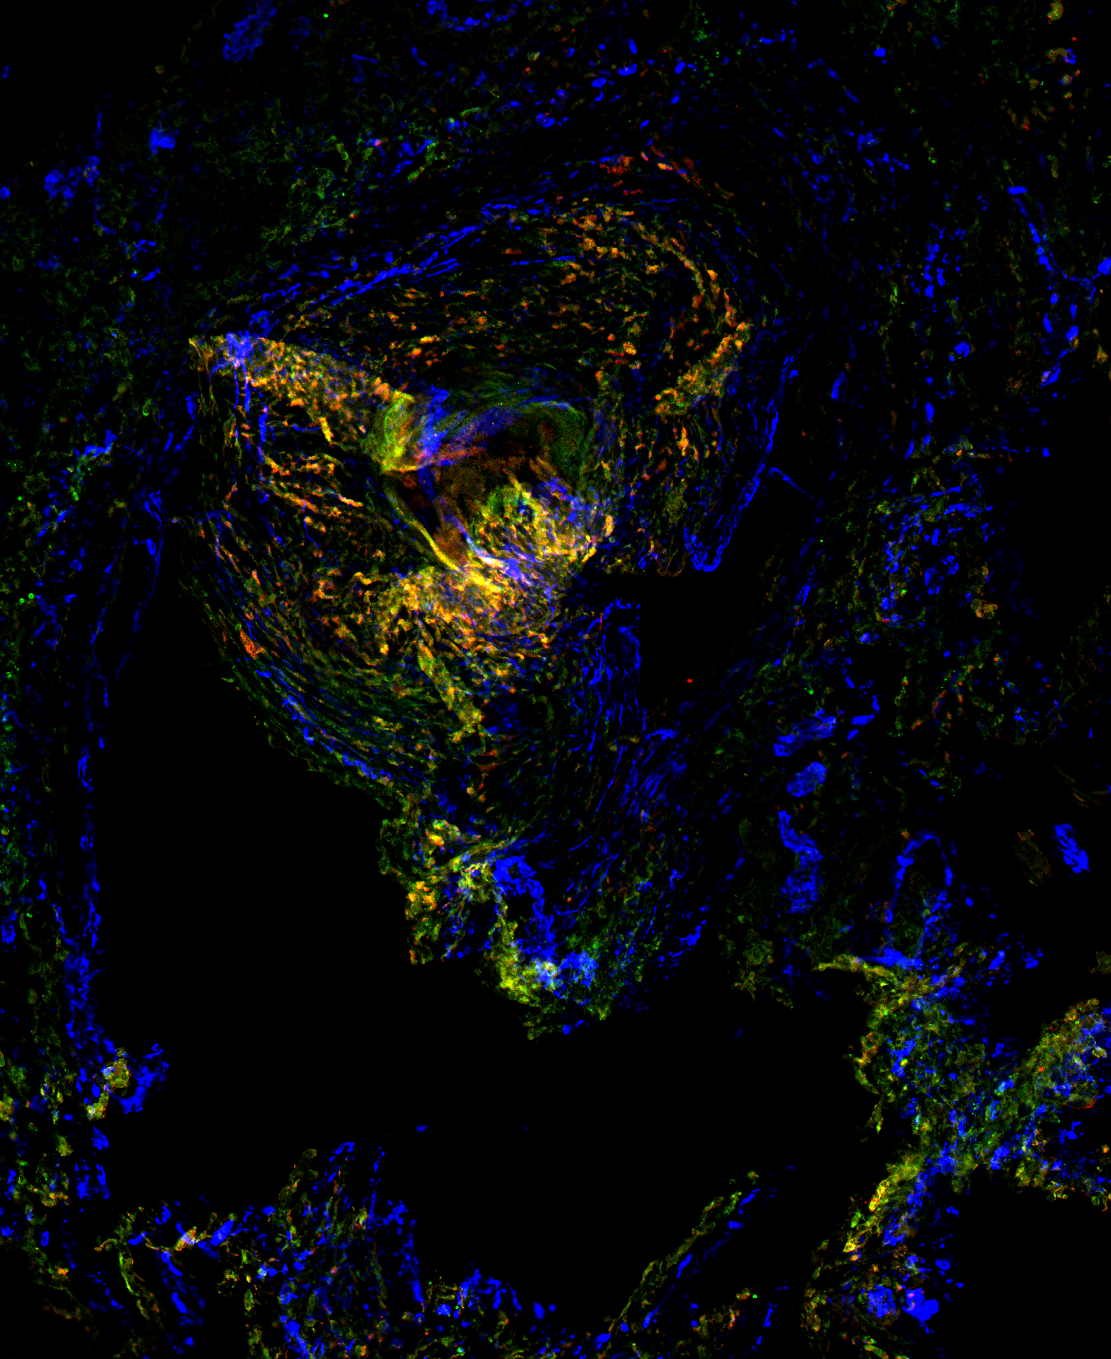
aSMA
Active TGFb
Latent TGFb
Notes:
Fibrocalcific TGFß and aSMA
Blue is aSMA
Red is active TGFb
Green is latent TGFb

Slide 8
Caseous
Non-necrotic
Caseous
Non-necrotic
Drug treatment
Fibrosis
Healed/FC
Healing
Active TGFß
Latent TGFß
Notes:
Get rid of transparent parts add stars

